Slide 1
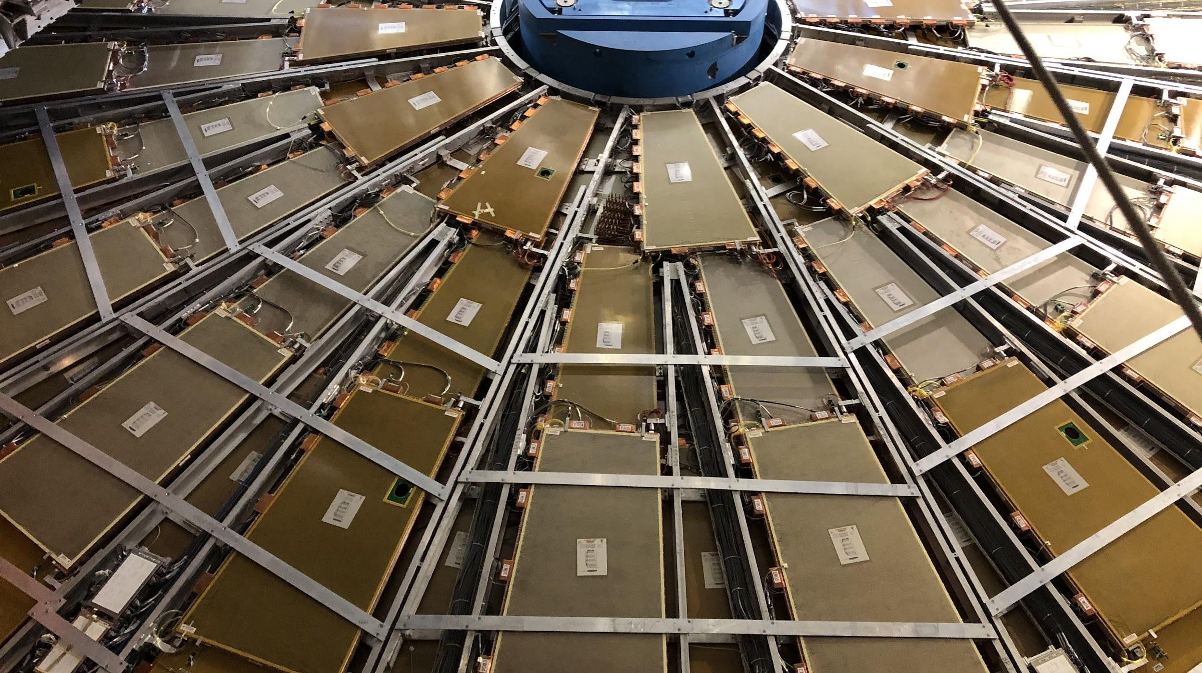


CIS Tech Update
Chicago Weekly Meeting, 27 September 2021
Dawit Belayneh and Katie Hughes

Slide 2
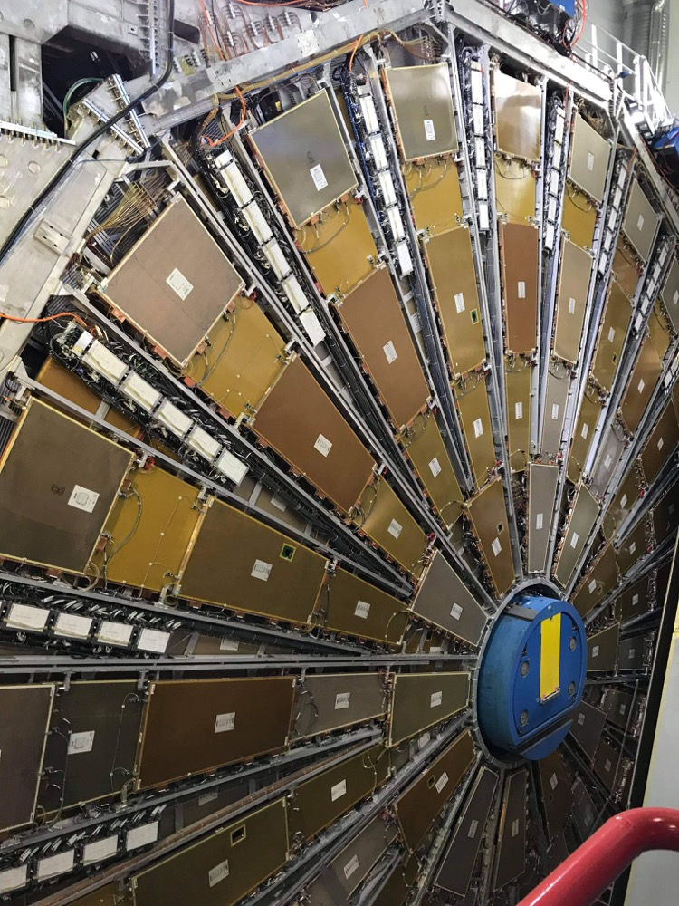
Outline
TileCal Electronics
Charge Injection System (CIS)
CIS and recalibration overview
Summary of July and August CIS updates
Cooling Valve Installations
Motivation
Installation Procedure
Current progress

Slide 3
TileCal Electronics

Slide 4
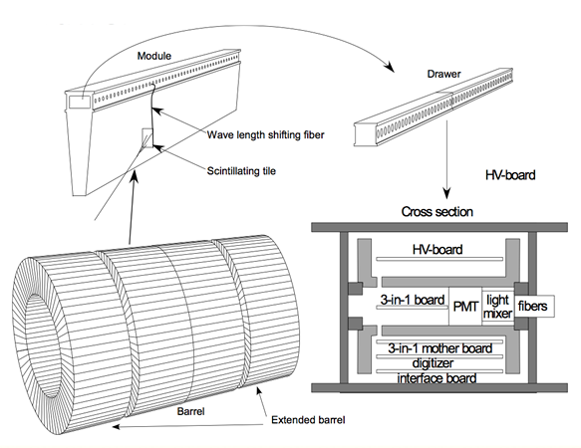
ATLAS Tile Calorimeter
4 Partitions
Long Barrel: LBA, LBC
Extended Barrel: EBA, EBC
64 modules per partition
Scintillating tiles in the modules emit photons when they are excited
Fibers deliver light to PMTs
EBA LBA LBC EBC

Slide 5
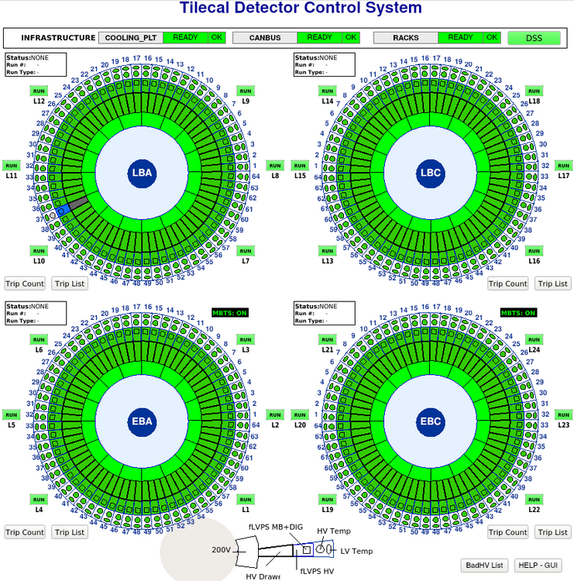
Detector Status

Slide 6
Charge Injection System (CIS)

Slide 7
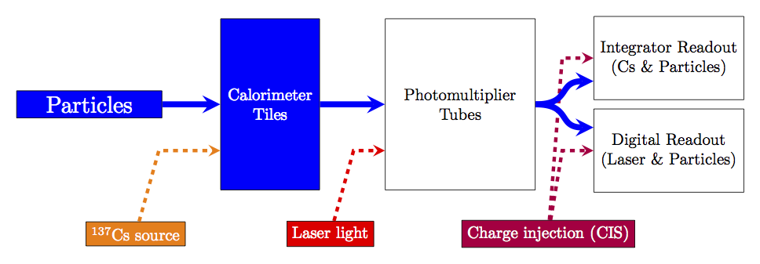
Overview
Calibration system for front-end readout electronics
Simulates physics signals by injecting a known charge and measuring the electronic response
Characterizes each readout channel with a CIS constant

Slide 8
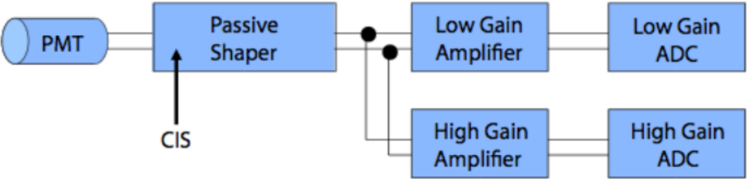
Charge Injection
3-in-1 cards contain 5 pF and 100 pF capacitors
Vary charge of injected pulse
64x gain amplifiers shape and amplify pulse
Pass pulse to analog-to-digital converter (ADC)

Slide 9
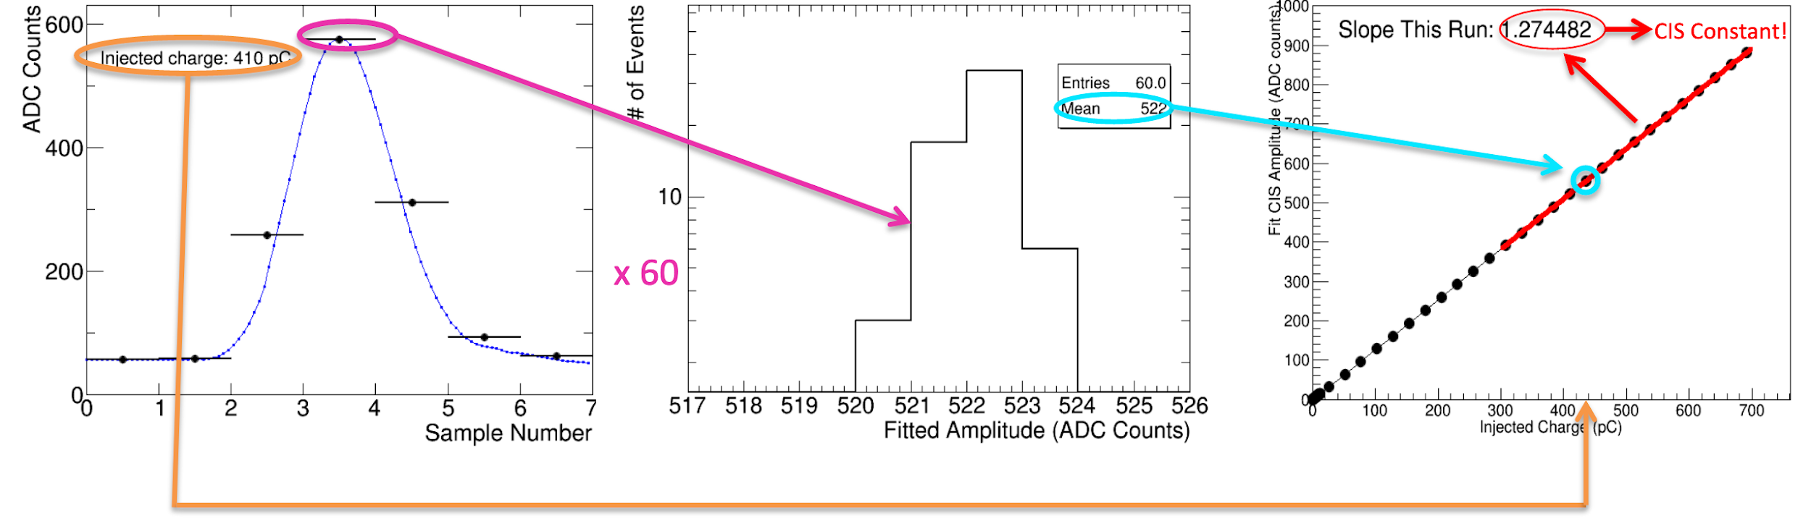
Calibration Constants
60 injections of a set charge sampled 7 times
15 steps varying phase between injection and sampling
4 capacitor discharges each
Mean amplitude of pulse measured for different charges
Amplitude (ADC counts) vs charge (pC) fit gives CIS constant
For each of ~19,700 channels!

Slide 10
CIS Constant Recalibration
CIS runs taken twice per week during LS2
Goal: verify maintenance and identify DQ (data quality) problems
TileCal Unified Calibration Software (TUCS) used to track detector performance and diagnose problematic channels
Calculate new constants within given interval of validity
Exclude outliers and stable outliers, identify DQ flags
Update databases approximately monthly

Slide 11
Procedure
Run a general TUCS script that generates plots of CIS constants vs time
Time range: last CIS update to present
Go through plots by hand to check validity of constants
Good CIS plots are very stable over time and close to the detector mean
Possible changes that need to be made manually:
Recalibration (run over a shorter time range)
Flag update (add BadCIS / remove BadCIS)
Exclude problematic runs for certain partition+gain combinations (bad timing, bad amplitude/charge ratio)
Add manual changes and upload constants to database

Slide 12
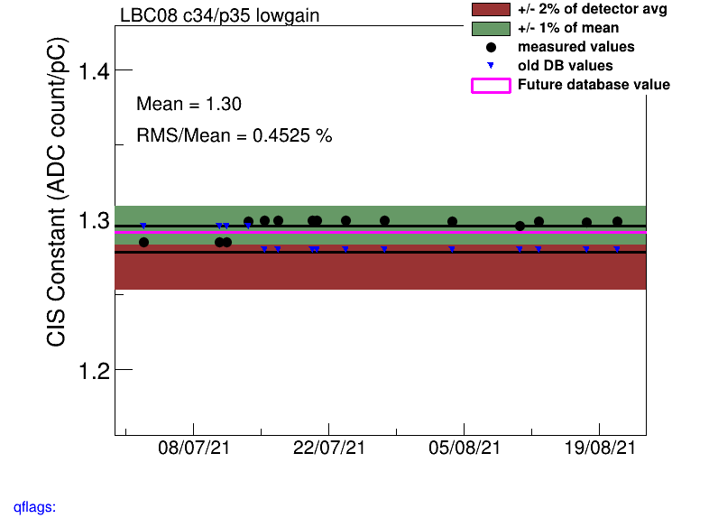
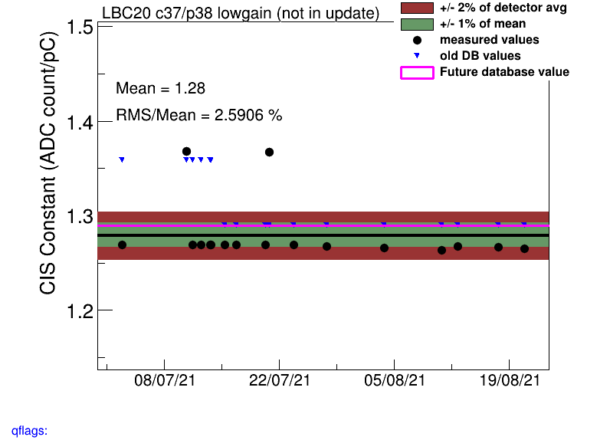
Recalibration
Often there is a constant shift in the CIS constant at some date, or 1-2 outlier points that skew the mean
Solution: run over a shorter time period, so long as the newer value appears stable

Slide 13
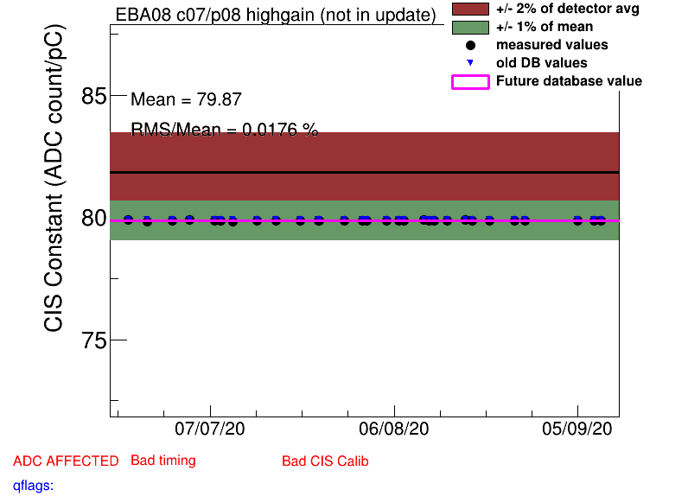
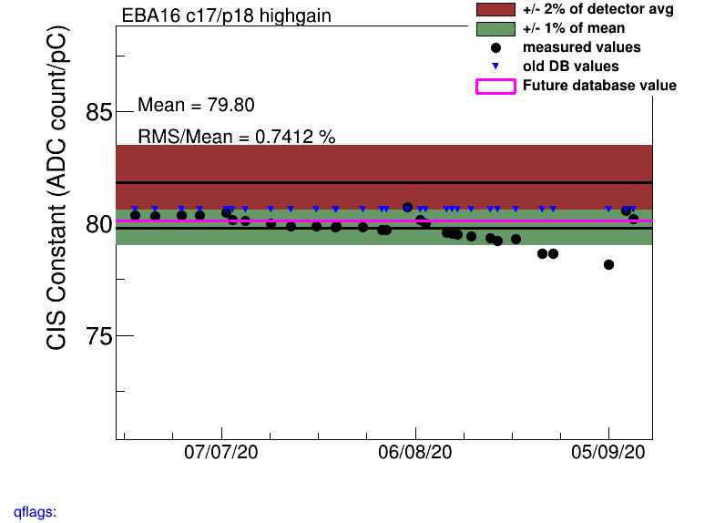
Flag Update
Sometimes channels are incorrectly flagged as BadCIS when they should not be, or vice versa
Notes:
Add some particularly dramatic examples!!!

Slide 14
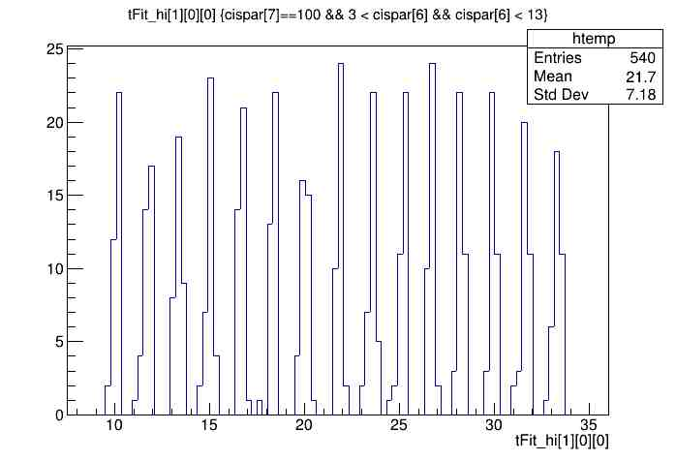
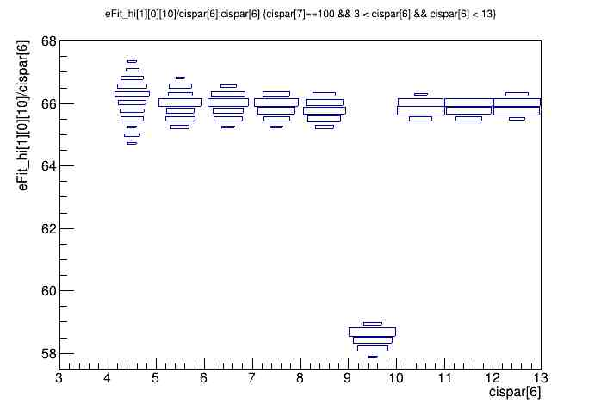
Timing and Amplitude/Charge Ratio
Timing should be consistent across all valid runs, typically in the range of (-15, 10) ns. Here, it’s shifted by +25 ns.
Amplitude/charge ratio for this CIS run in LBC highgain is unstable, so we should not use it.
Notes:
Add examples!!!

Slide 15
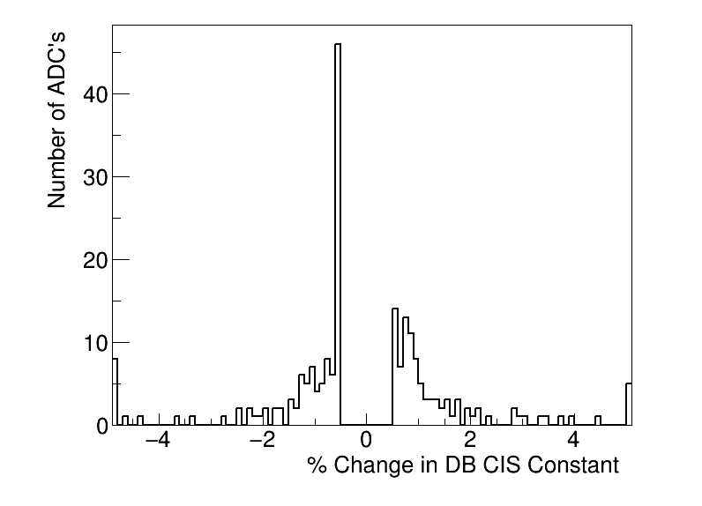
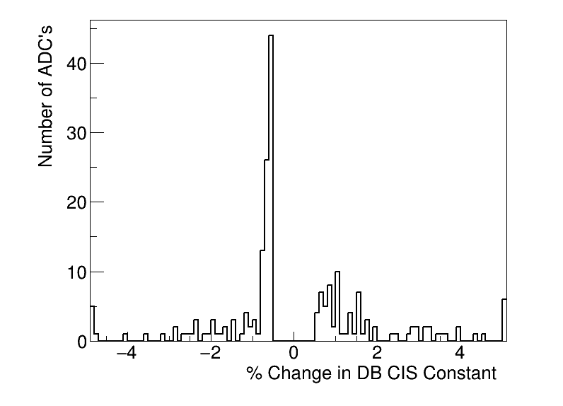
CIS Update Summaries
July 5
CIS runs from June 1 - July 2
214 channels in the update
12 channels with >5% change
Aug. 23
CIS runs from July 2 - Aug. 20
178 channels in the update
11 channels with >5% change

Slide 16
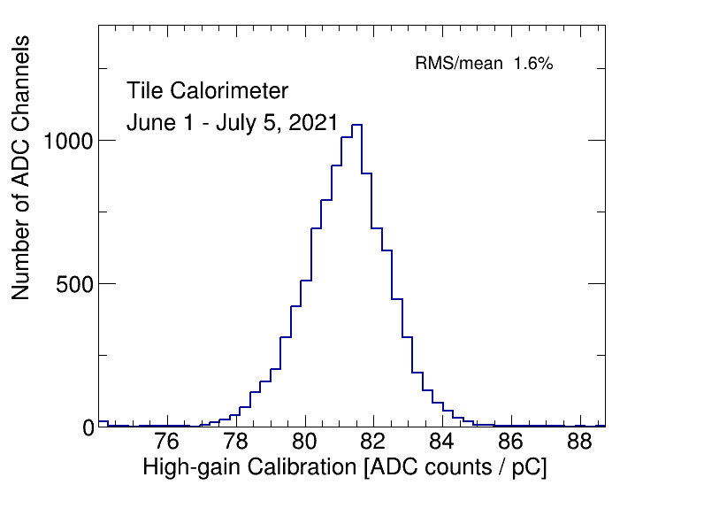
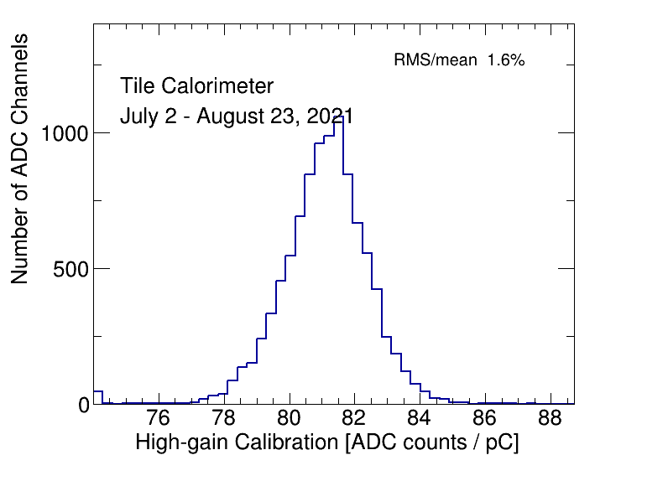
CIS Constant Distributions (High Gain)
Should be Gaussian and centered around 81 ADC counts/pC

Slide 17
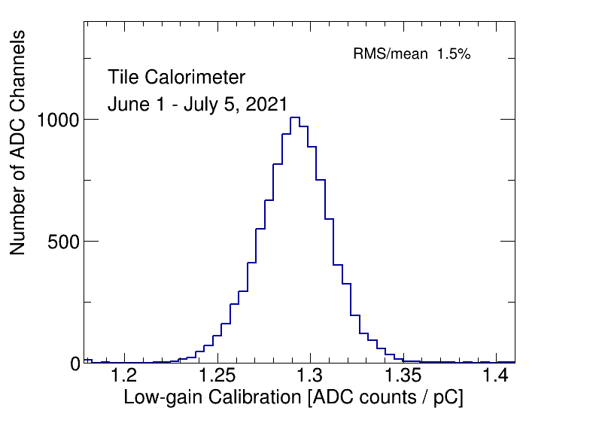
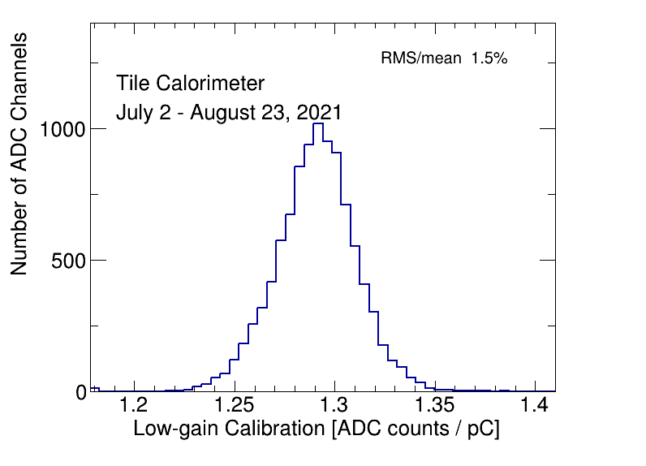
CIS Constant Distributions (Low Gain)
Should be Gaussian and centered around 1.29 ADC counts/pC

Slide 18
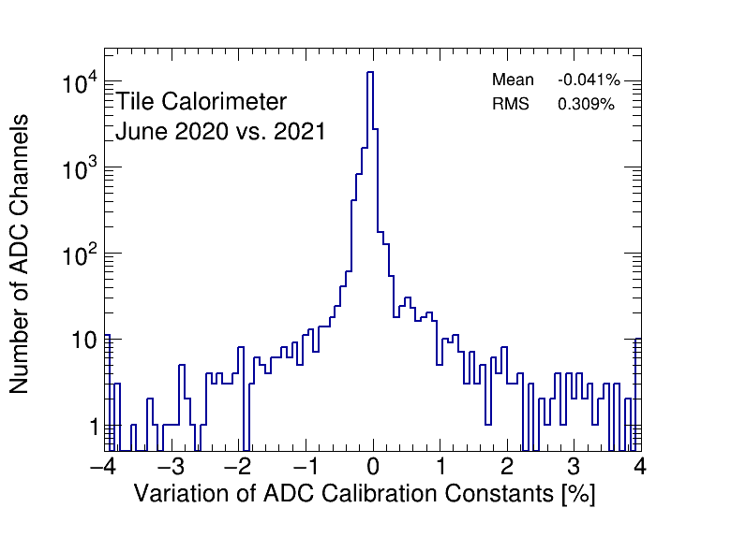
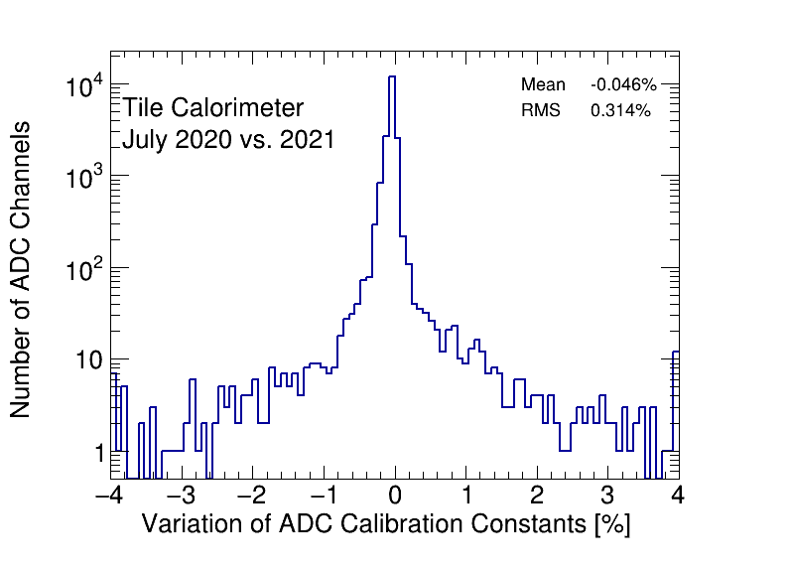
CIS Constant Stability

Slide 19
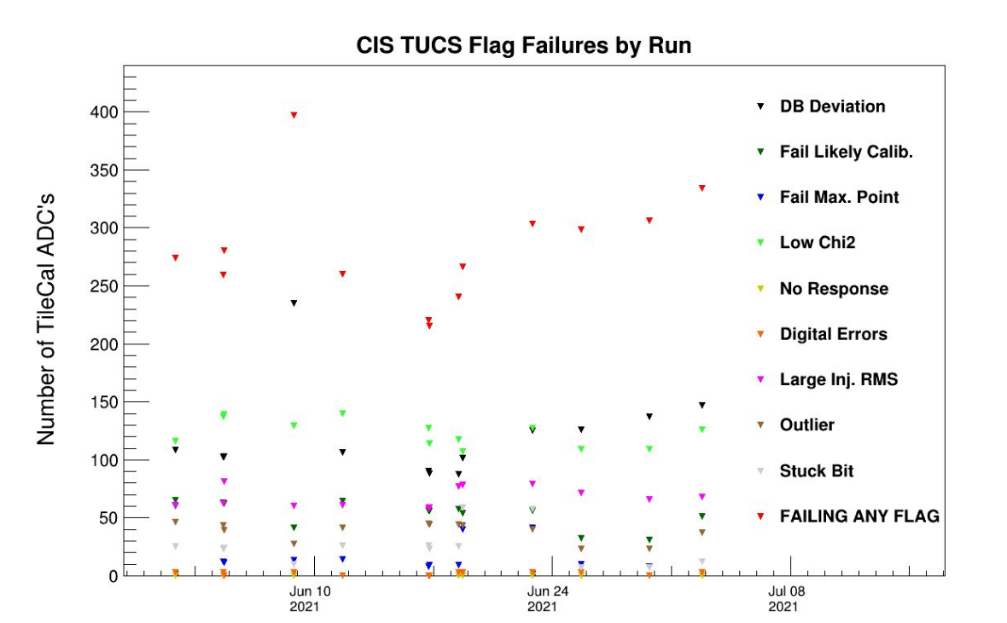
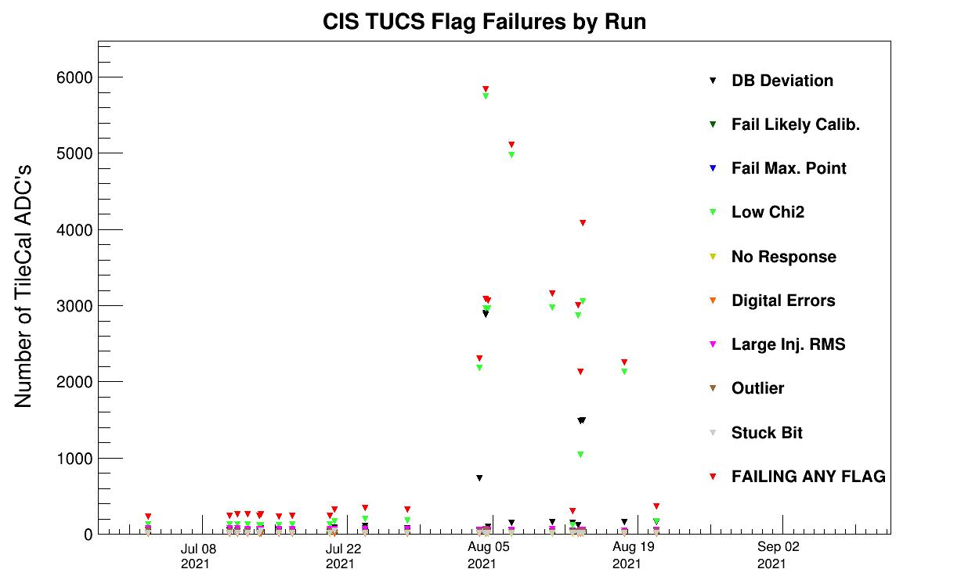
TUCS Quality Flags
ALTI upgrade work happened around this time, many settings were still being fine-tuned

Slide 20
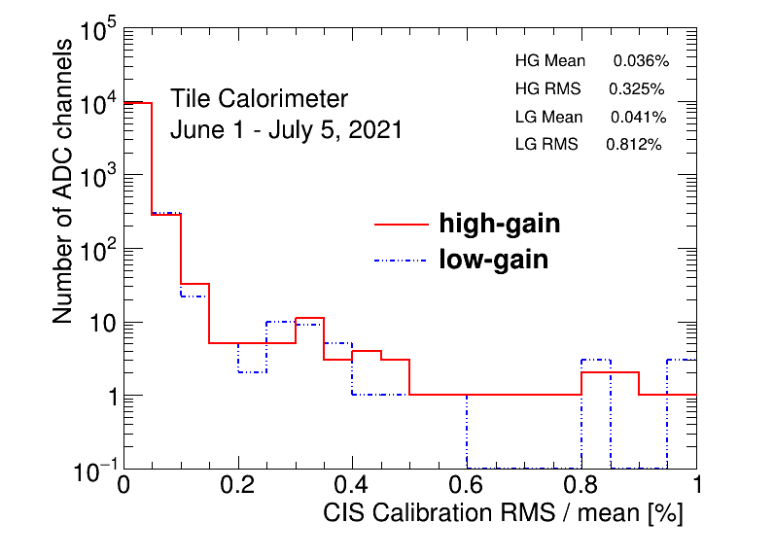
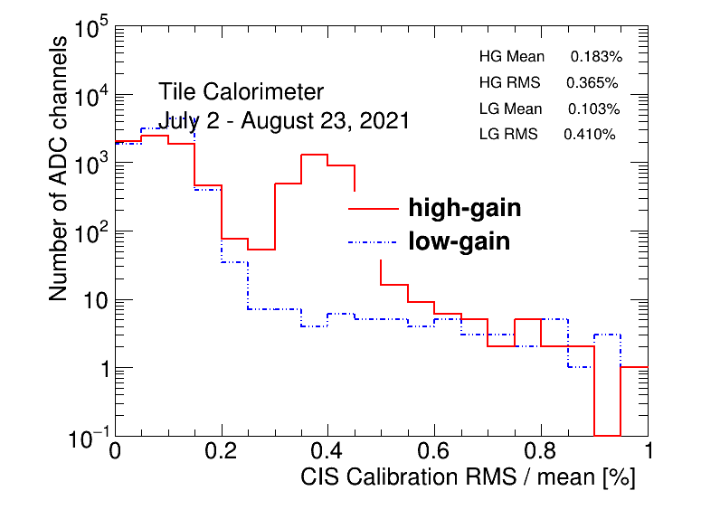
CIS Constant RMS/Mean
This plot is bad, but expected, as there is a different set of valid runs for each partition and gain combination. Currently these plots can only be made using all runs (something that we would like to change for future CIS updates).

Slide 21
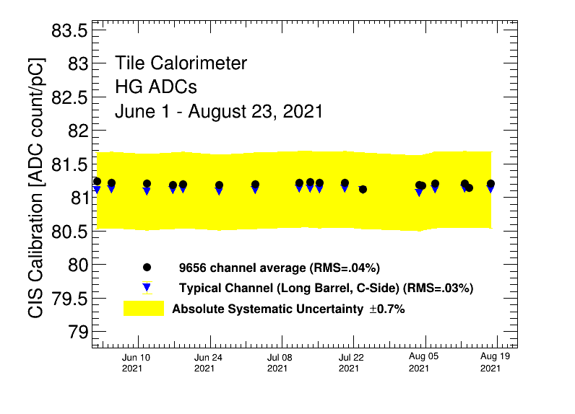
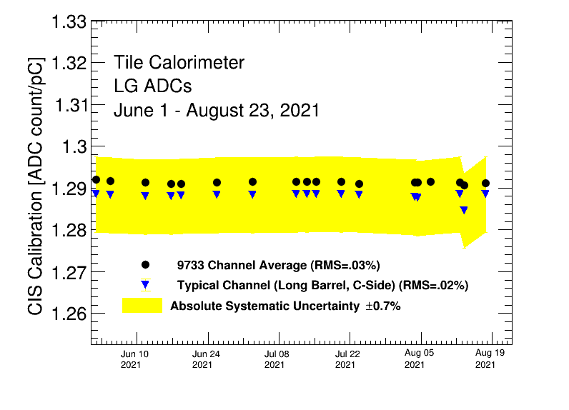
Detector Stability
This spike might also be attributed to the ALTI upgrade work that was happening around this time, or the fact we could not specify the different sets of valid runs.

Slide 22
Next Steps
Starting CIS update for September this week
Continue figuring out ways to streamline the update process
Create a new TUCS script / wrapper that allows us to specify different valid runs for different modules in one command
Can sort of accomplish this with a bash script, but we think there is a more concise way to do it
Would allow us to produce accurate cumulative plots
Mass produce timing and amplitude/charge plots so we can quickly verify if a run is good

Slide 23
Cooling Valve Installations

Slide 24
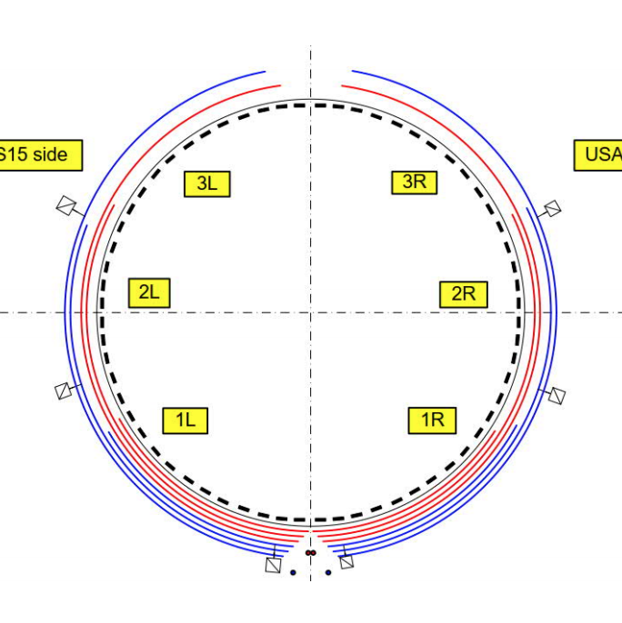
Motivation
Currently, a single cooling loop passes through 8-12 drawers
6 loops per partition
A leak in one drawer means all other drawers in the loop must be shut down to fix it
Valves will now isolate leaks to a single drawer
Cooling Loop Distribution

Slide 25
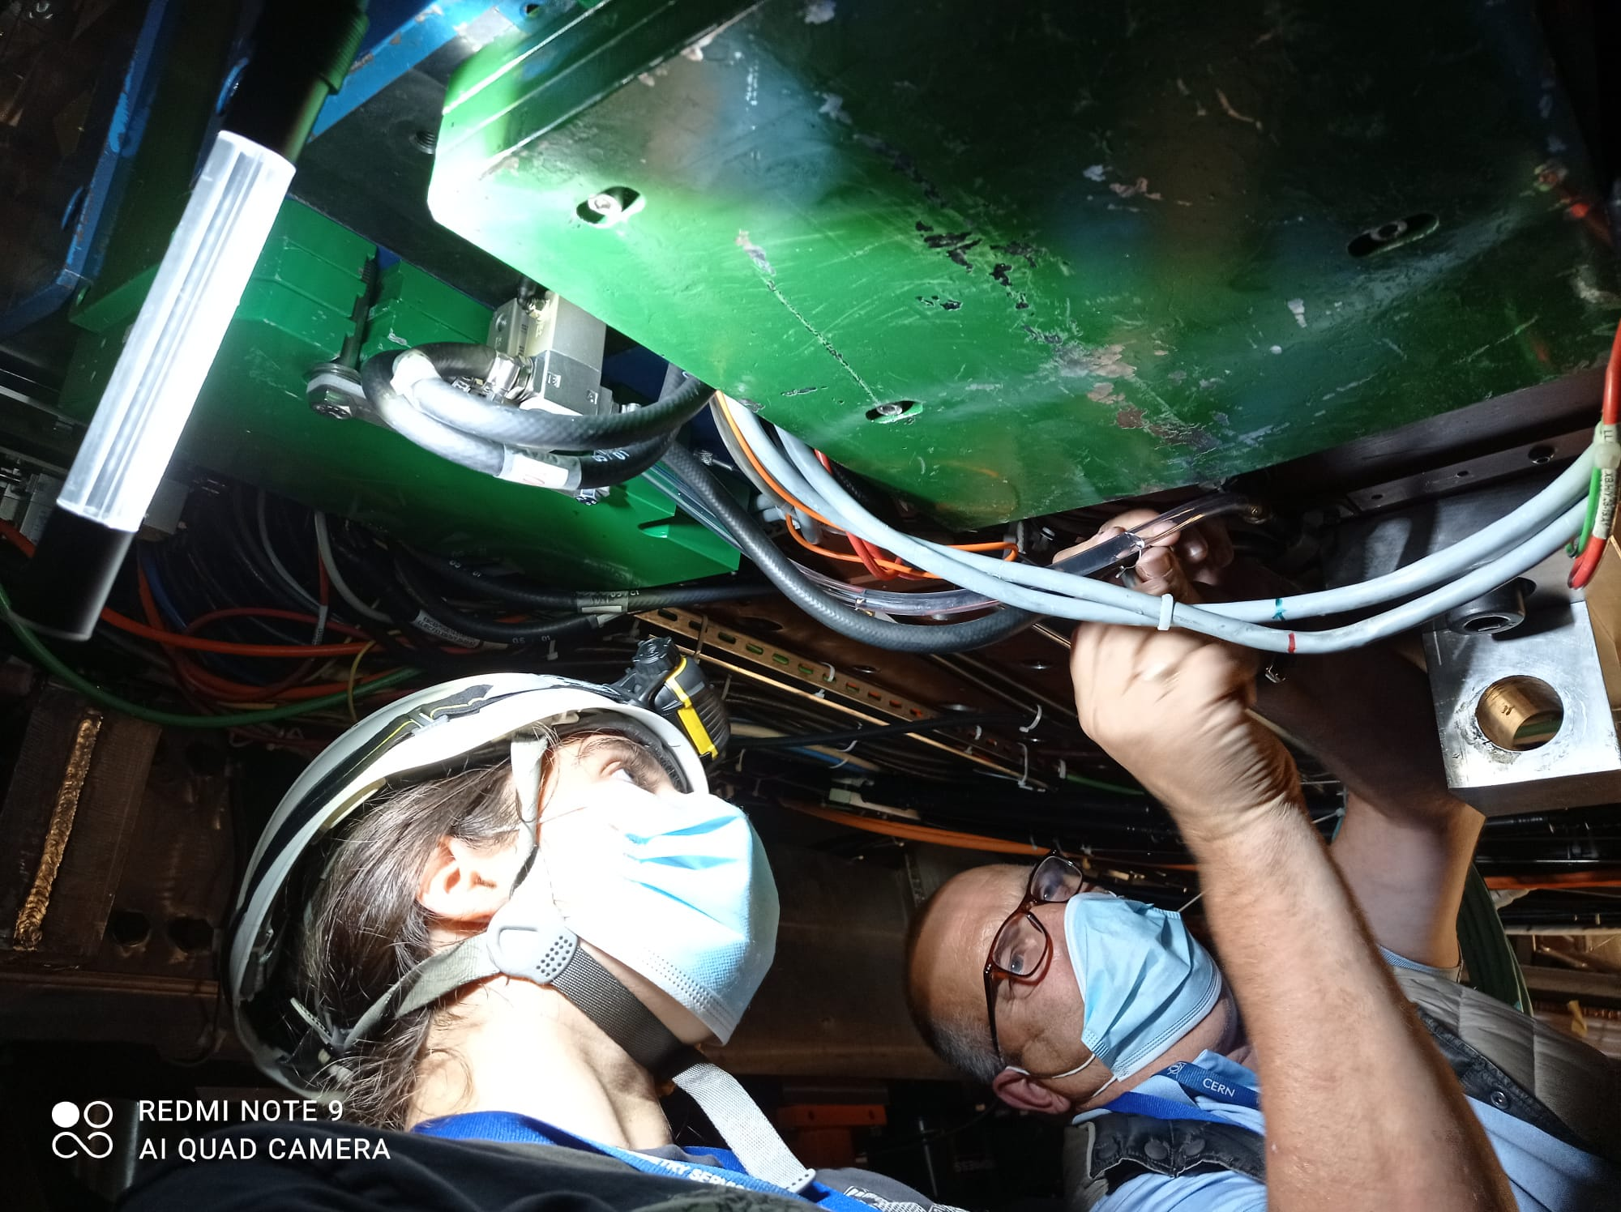
Installation Procedure
Build and test valves
Identify drawers and appropriate cooling loop
Mount brackets with valves on accessible drawers
Stop cooling loops, connect hoses to valves, restart loops and check for leaks

Slide 26
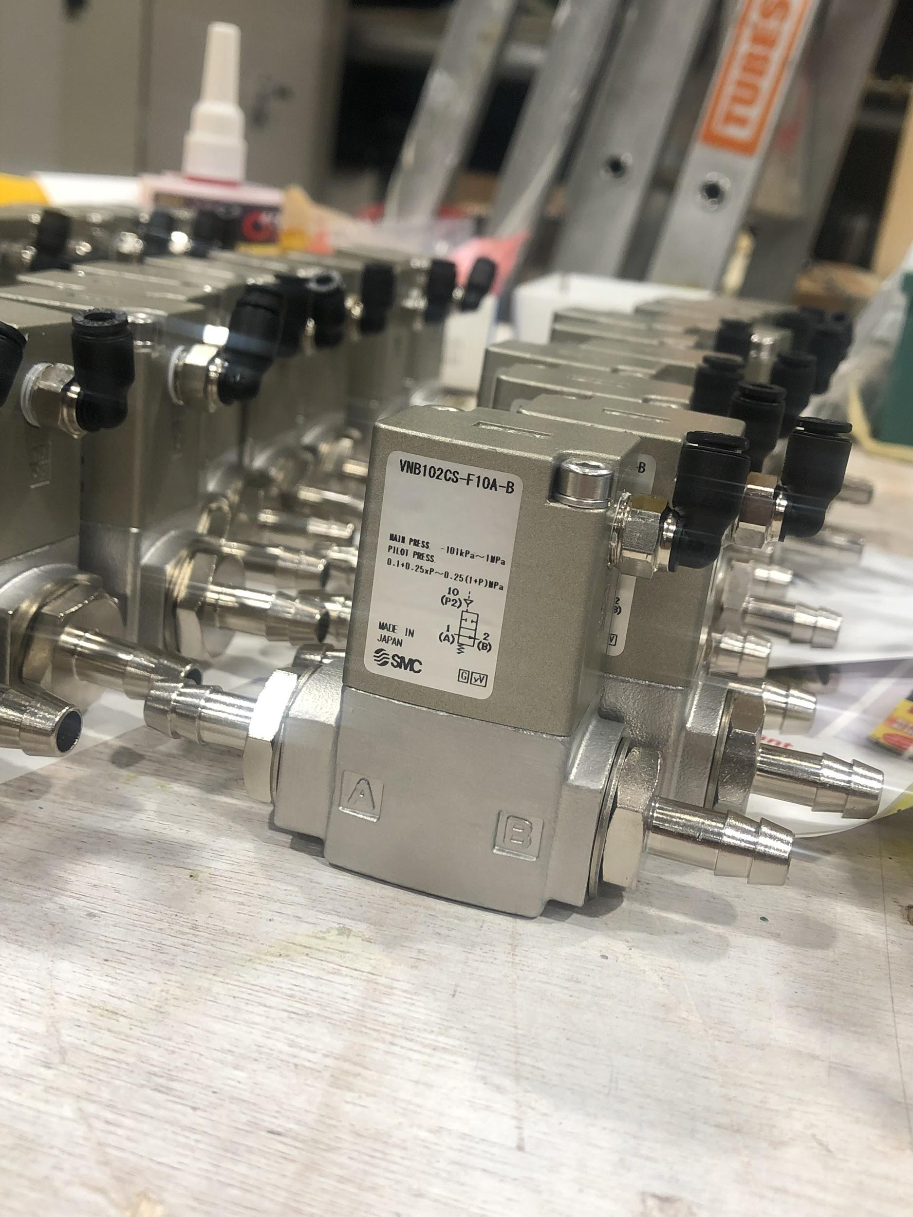
Building and Testing Valves
Add non-magnetic and radiation-resistant parts
Let valves sit for >24 hours so that seal adhesive has time to dry
Test seal quality under pressure. If valves pass, they are ready to be installed
We have made ~120 and 0 have failed!

Slide 27
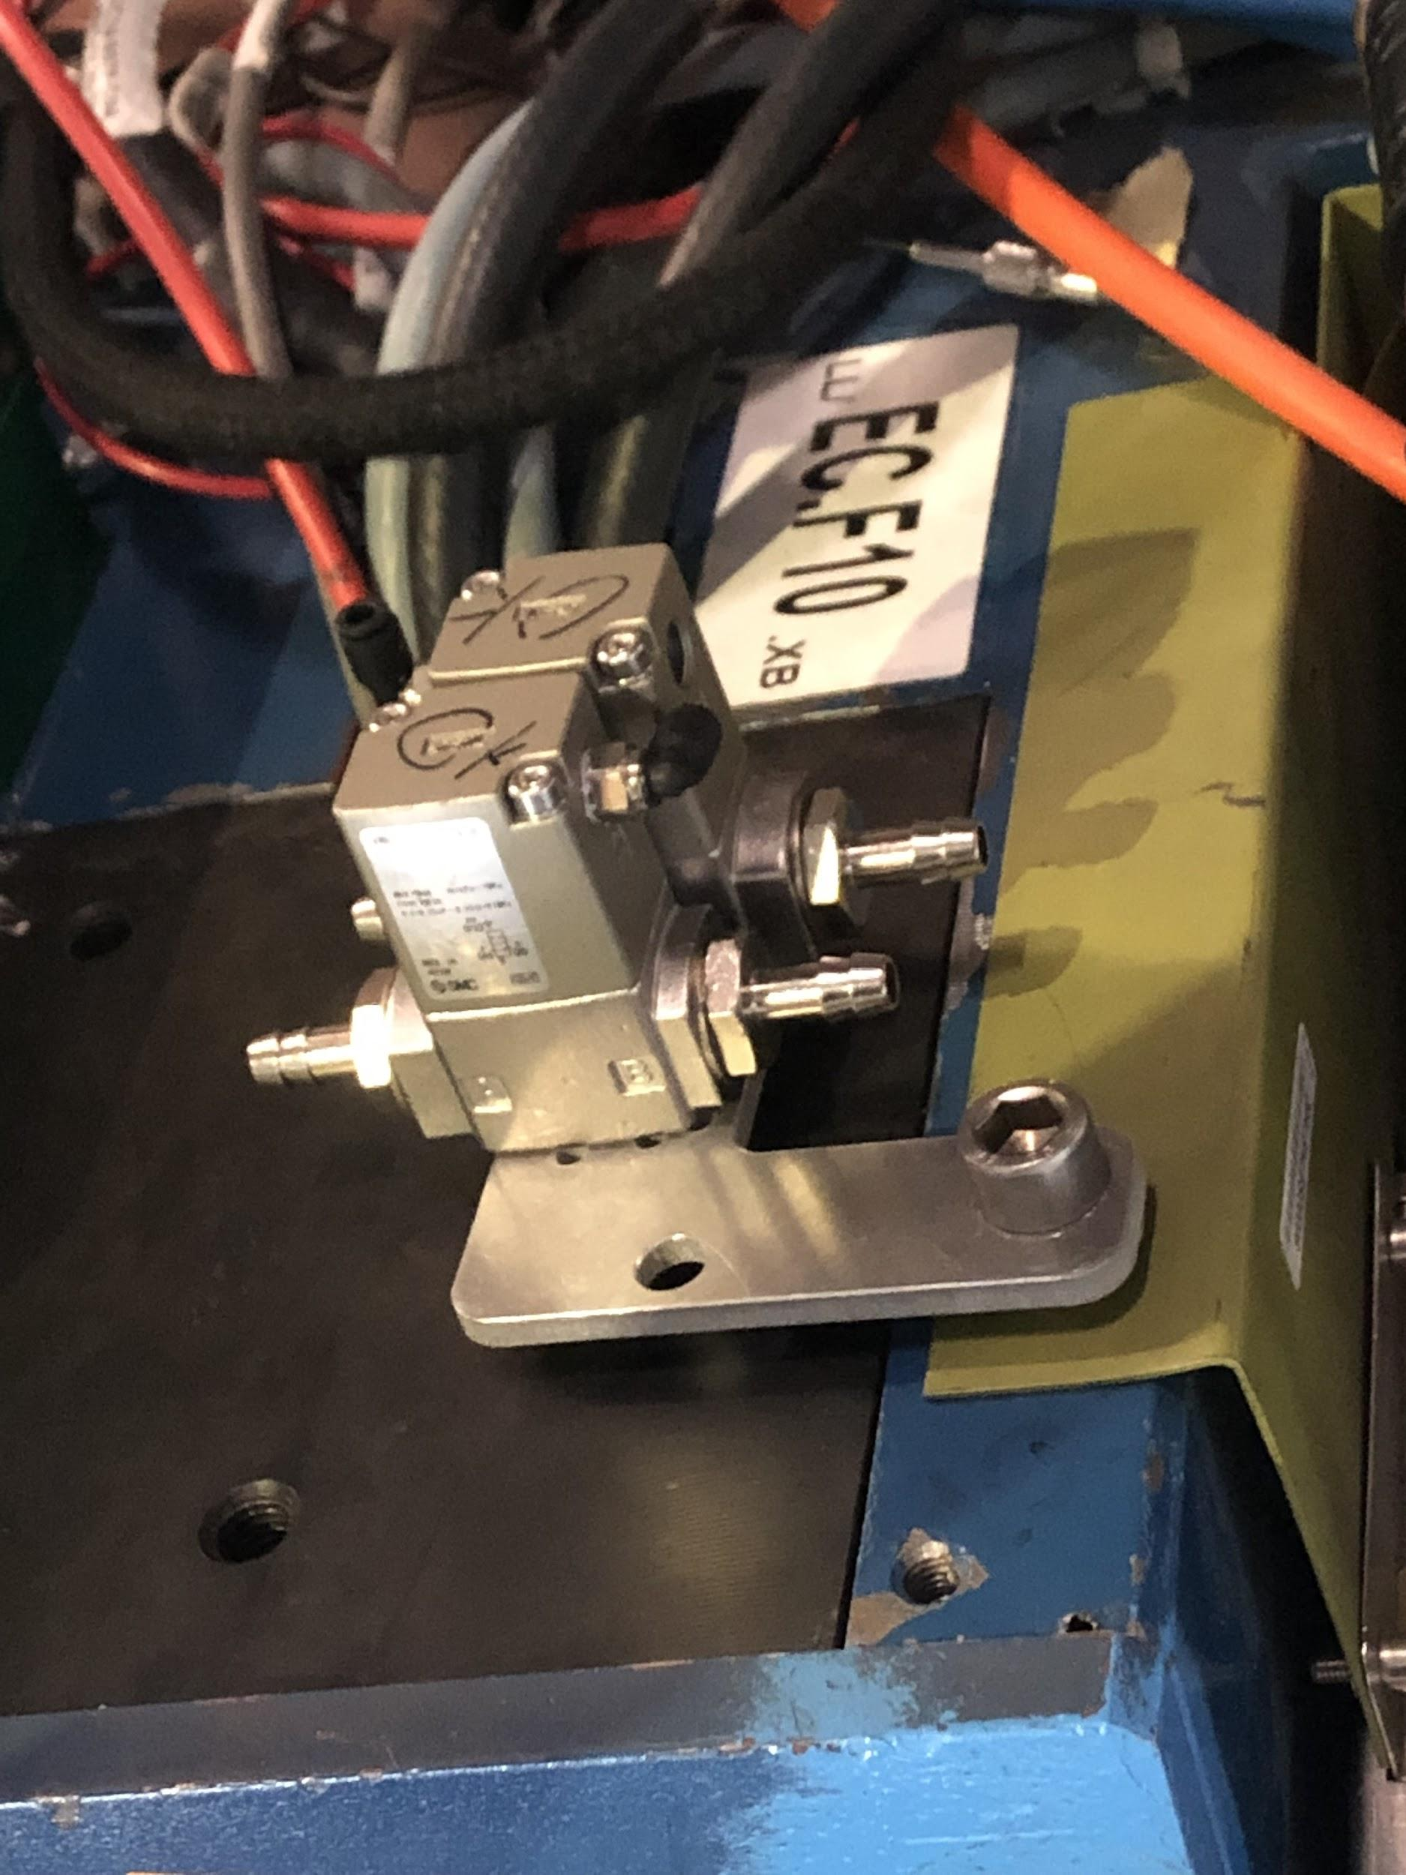
Mounting Valves
Have a variety of different shapes of mounting plates
Orientation is critical!
Hoses must be able to reach valve nozzles without bending too much
Valve nozzles must not be too close to walls/other wires
Ideally plates should be secured with two bolts, but sometimes that is not possible

Slide 28
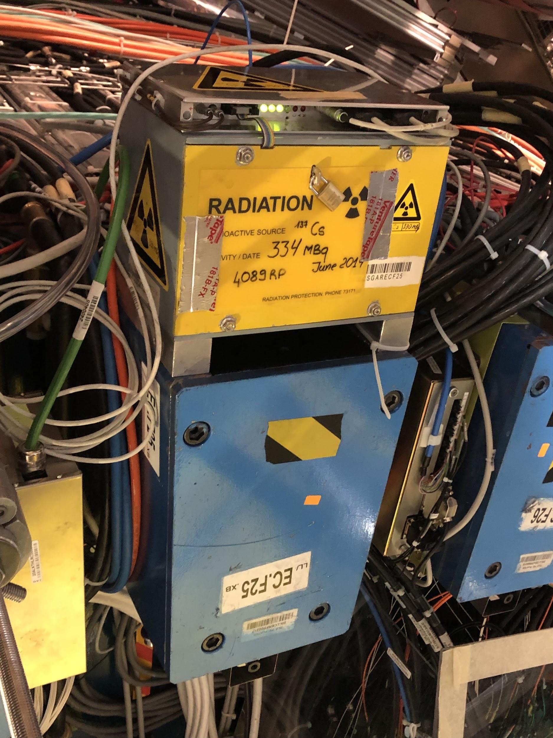
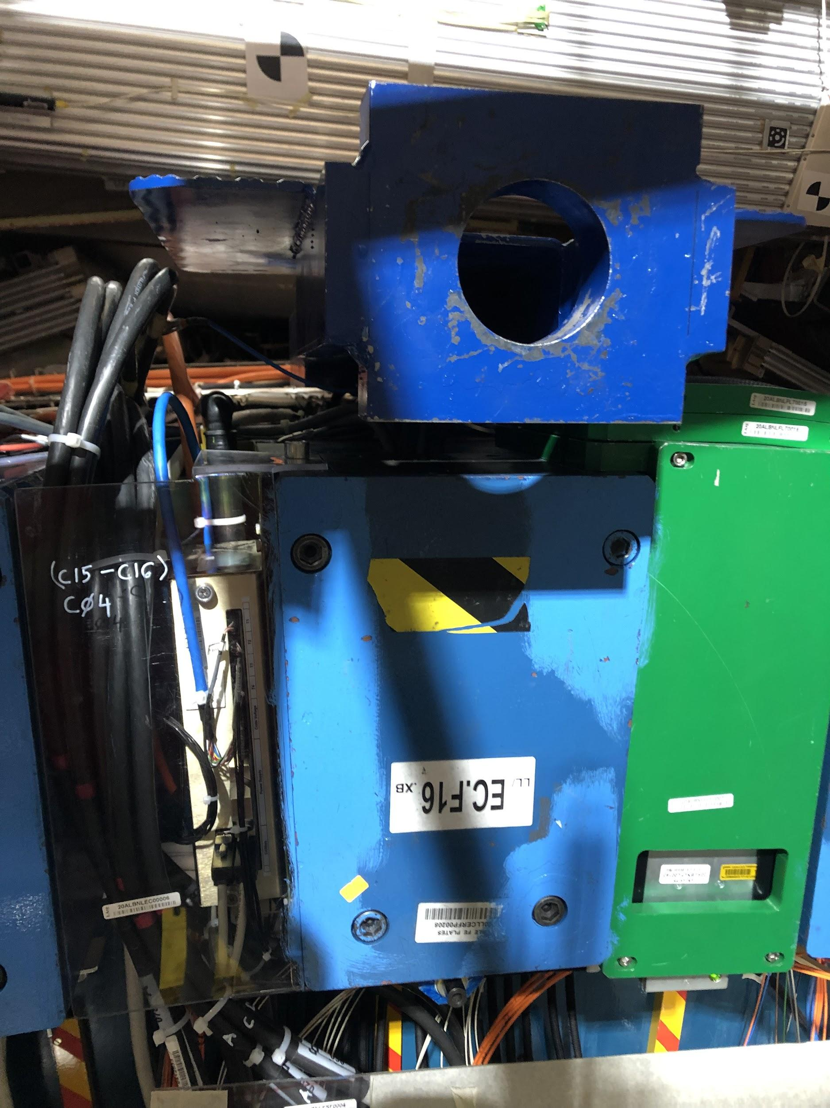
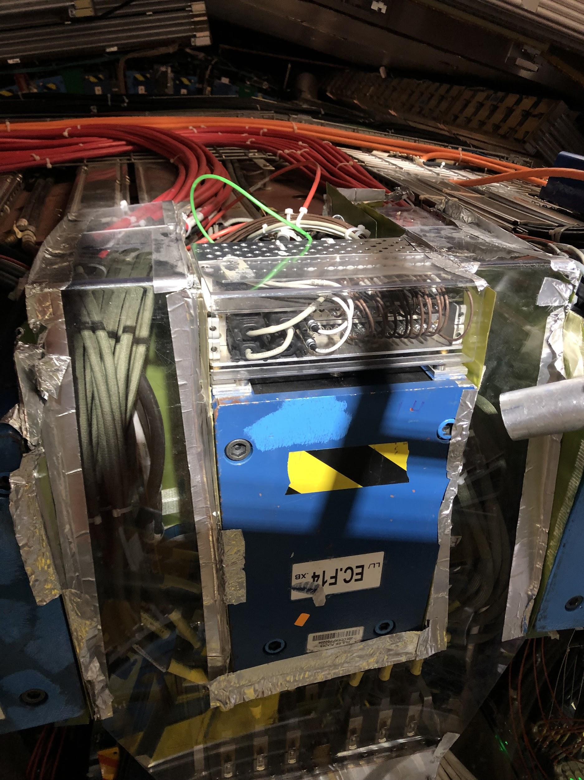
Difficulties with Mounting
Cesium box blocks most of the space for mounting
No space on top due to wires, can’t access the sides either
Beam blocks valves from fitting underneath

Slide 29
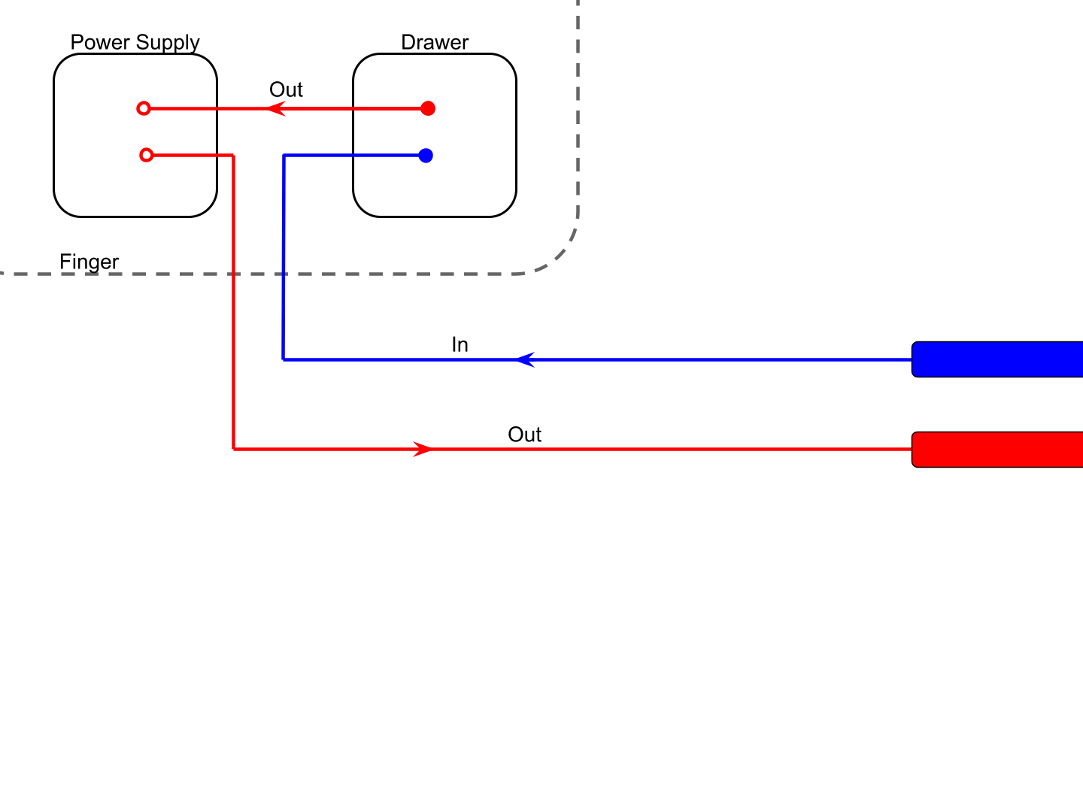
Initial Hose Connection
Pipes

Slide 30
Old Method
Disconnect hose from inside drawer, cut+insert new longer hoses so that they reach the valves
Cut pre-existing hoses here to fit into the other side of the valves

Slide 31
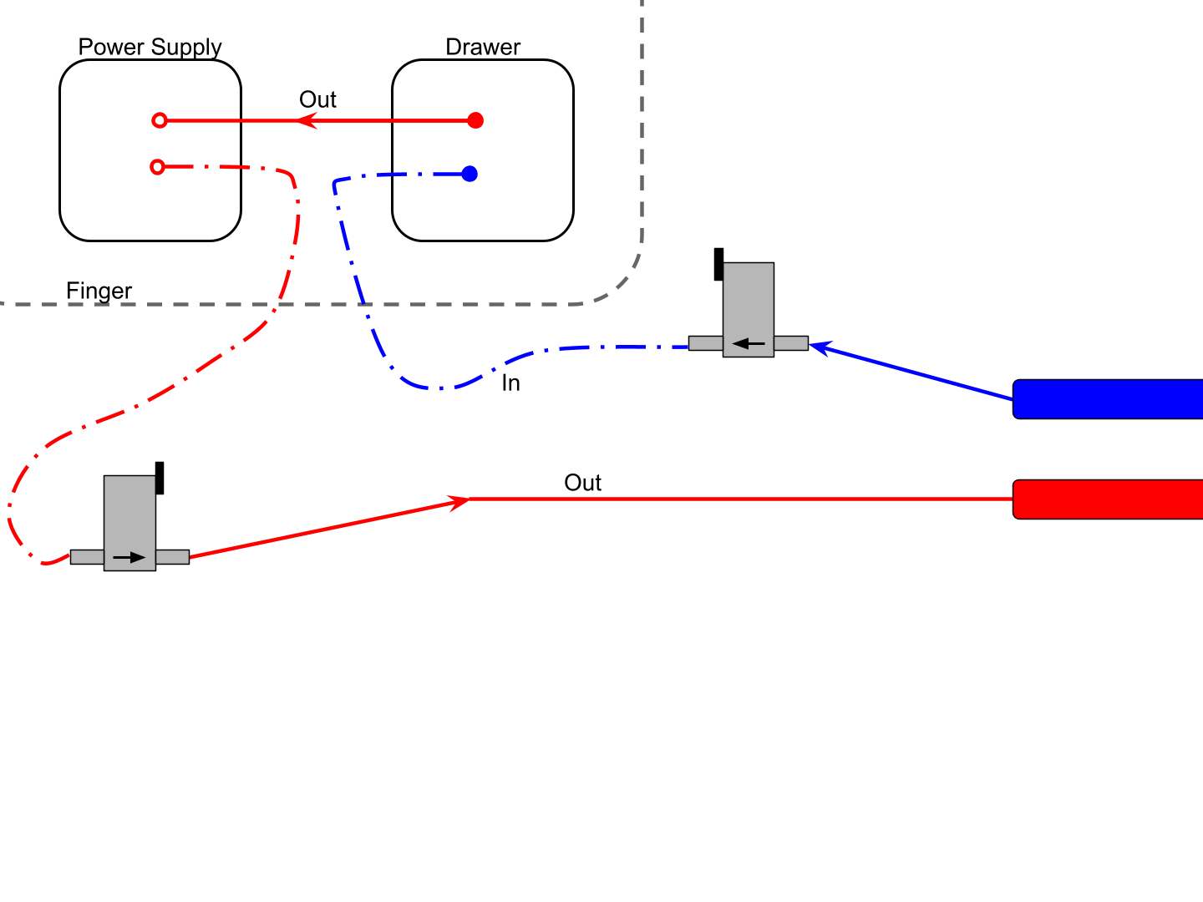
Old Method
Very time intensive, we have to open drawers and also add male/female connectors on the new hoses we cut (something we did not have a lot of).

Slide 32
New Method
Disconnect hoses here -- don’t touch the hoses inside the drawer. Cut new hoses and fit their end to the in/out pipes.

Slide 33
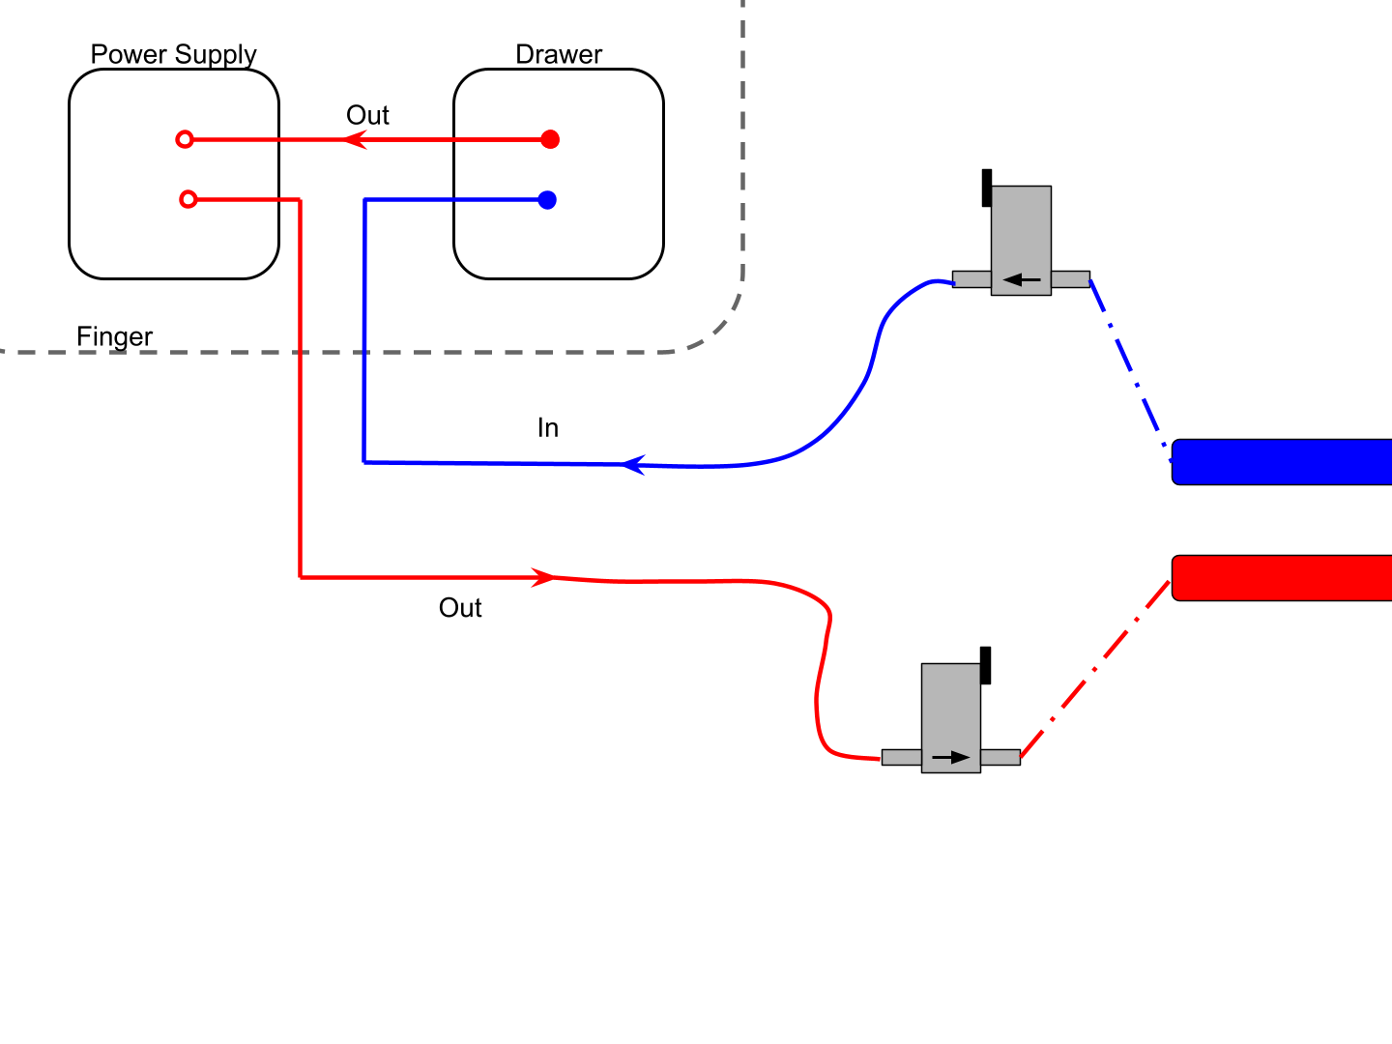
New Method
This is a much quicker method as we don’t have to open the drawers! However, sometimes it can be awkward to reach the in/out pipes as often they are far away from the scaffolding.

Slide 34
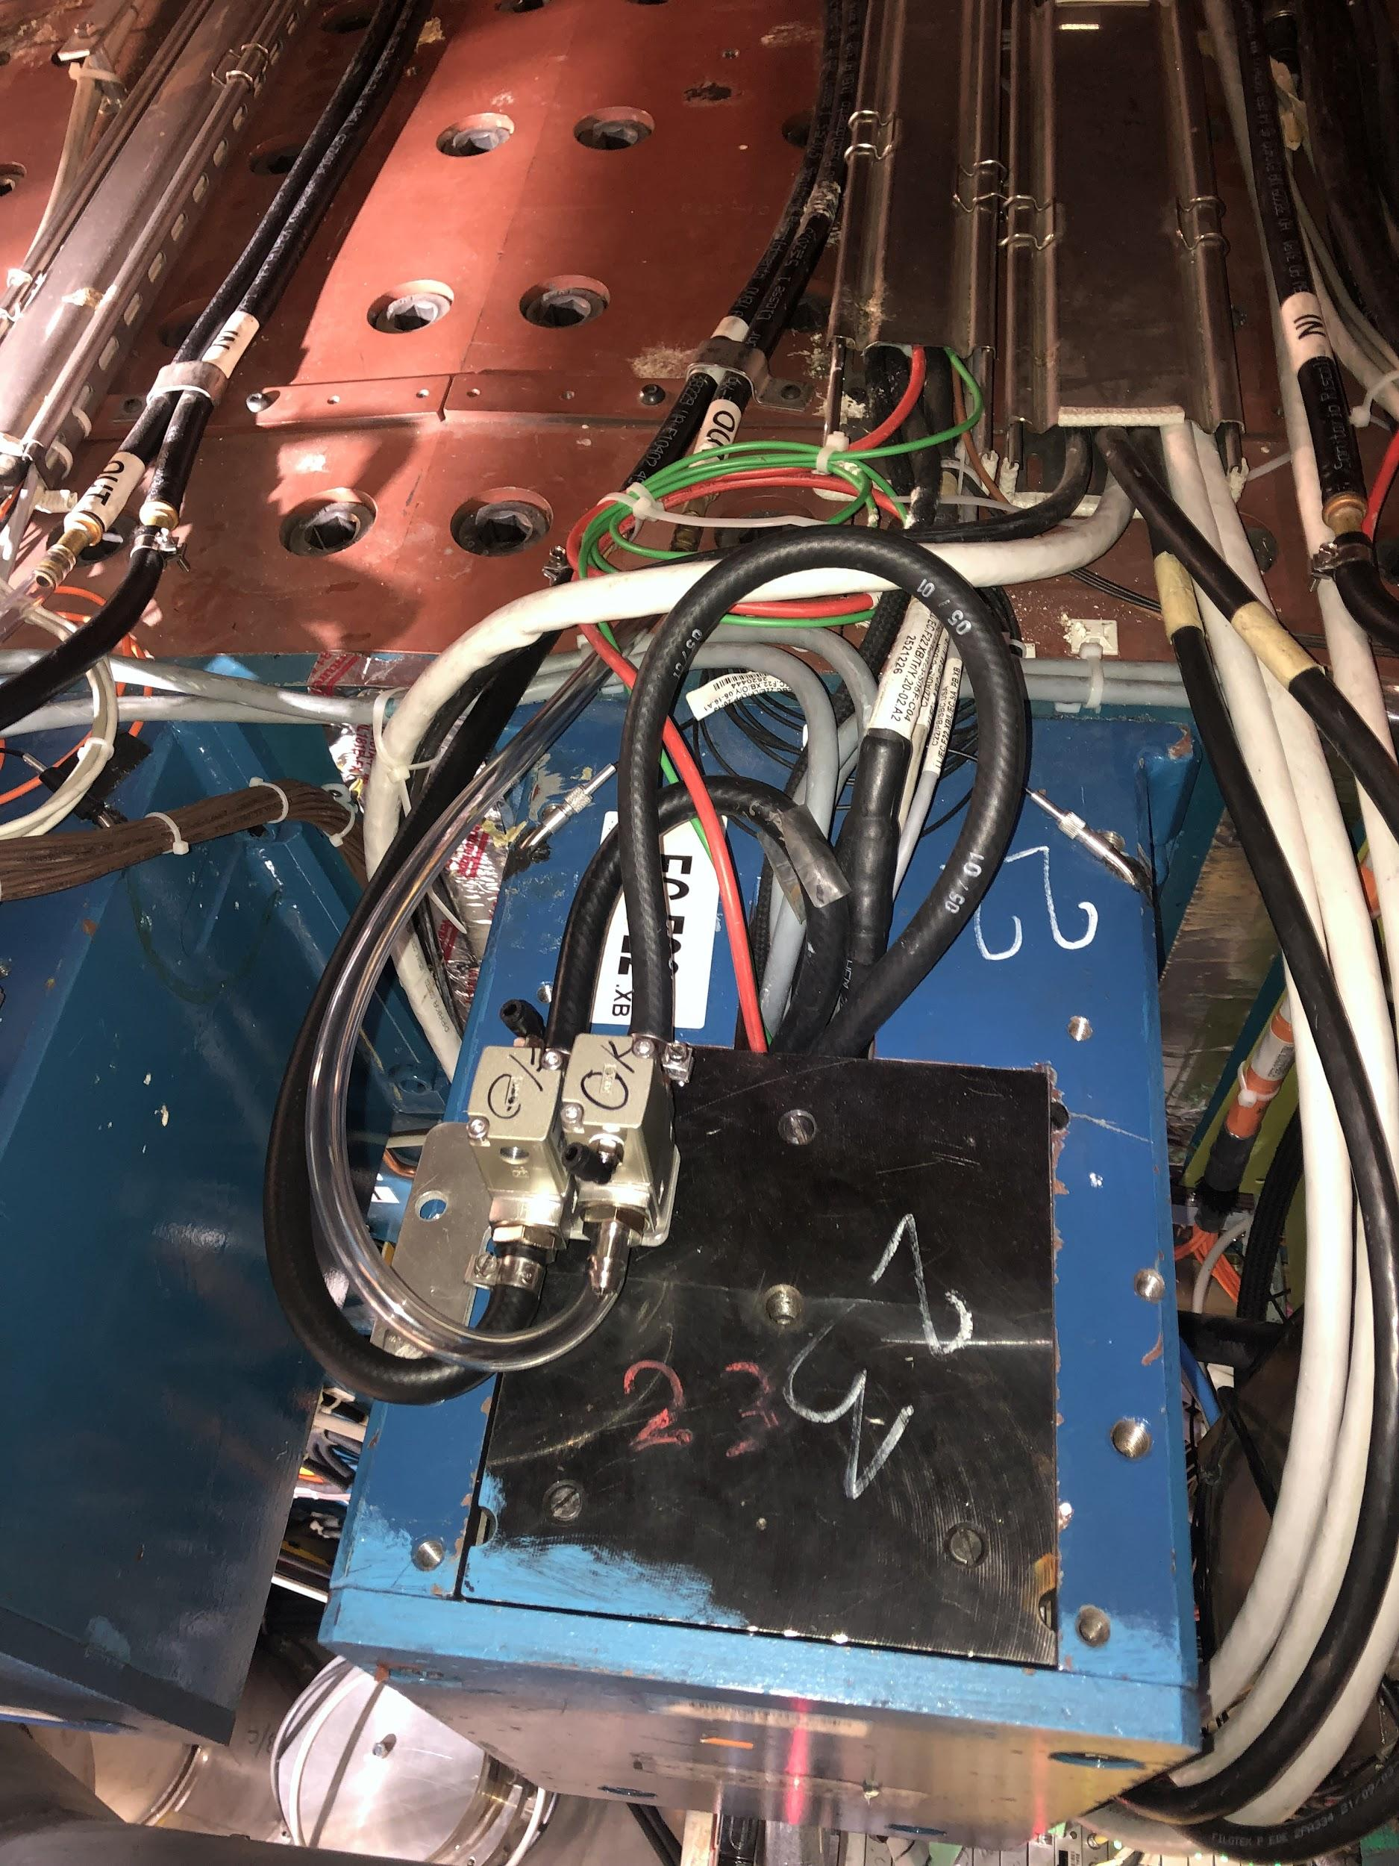
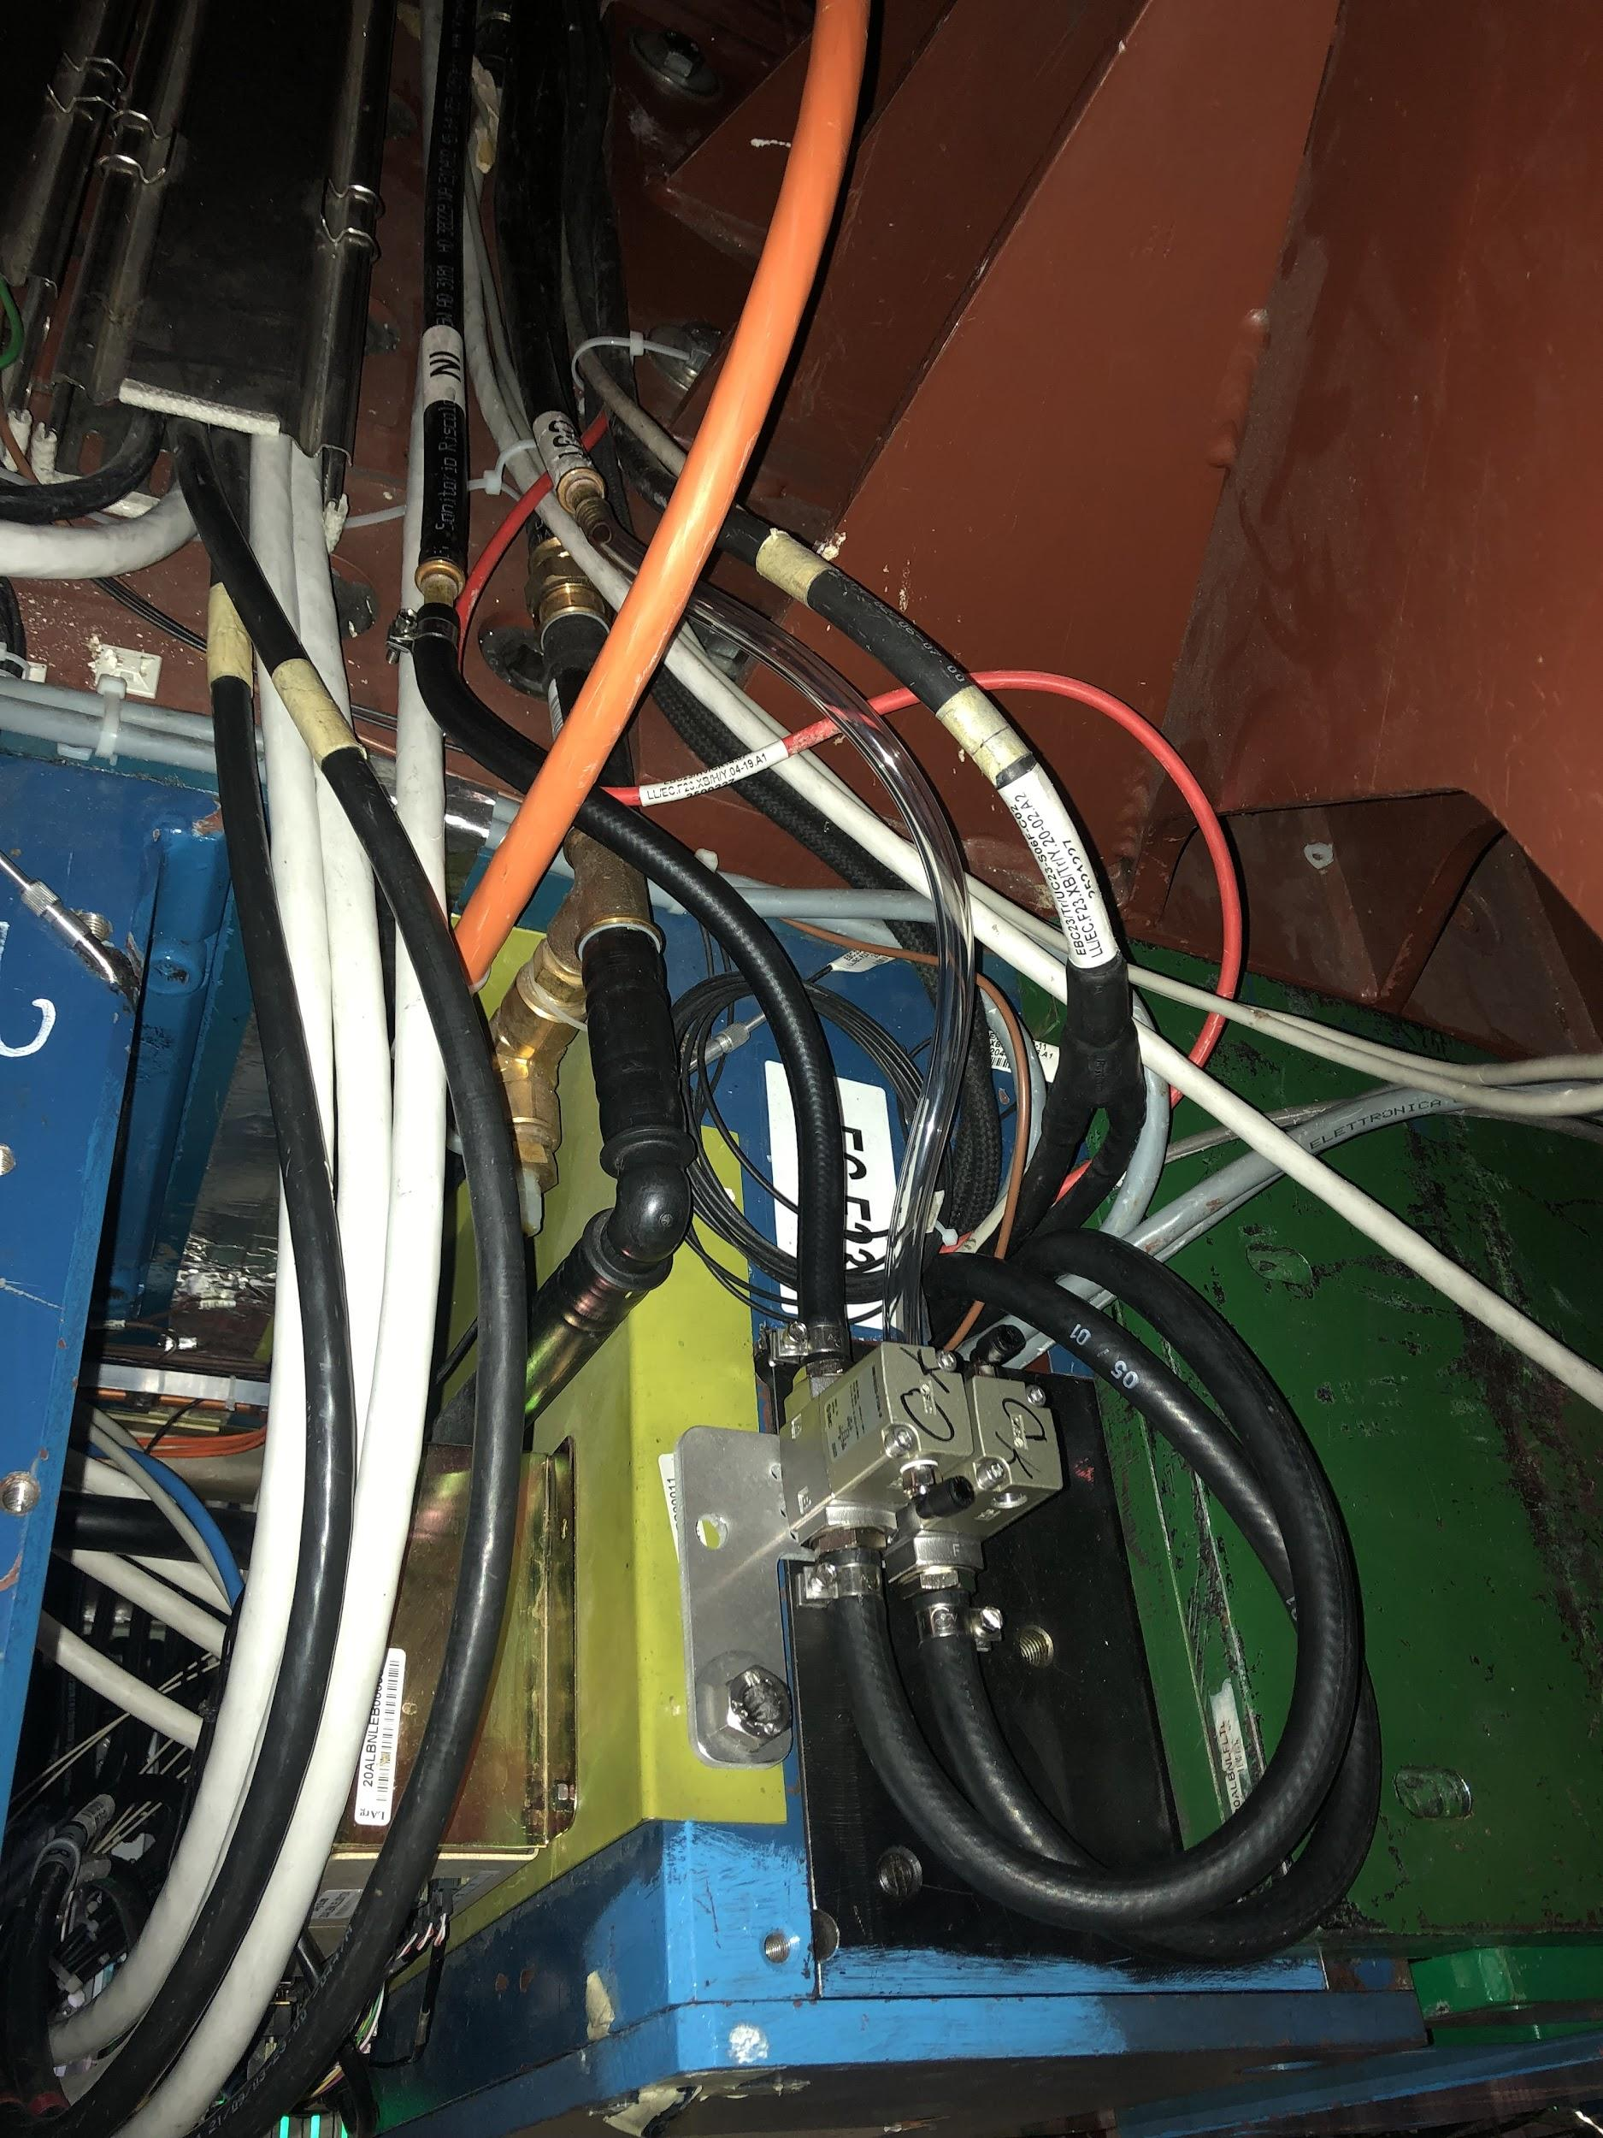
Examples

Slide 35
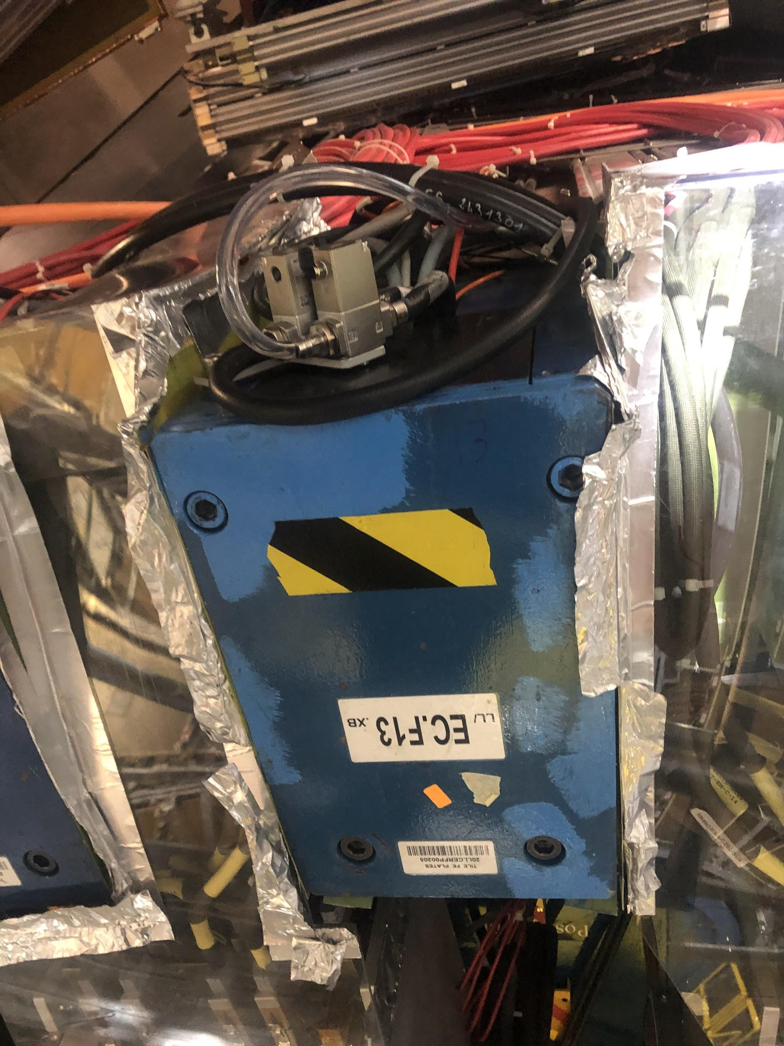
Identifying Leaks
Check PPV cycle
How often cooling system must be pumped down to a lower pressure
The hoses we attached to the “out” pipe are clear so we can look for bubbles
Will replace them with standard black pipes later
When leak suspected, use clamp to isolate drawer

Slide 36
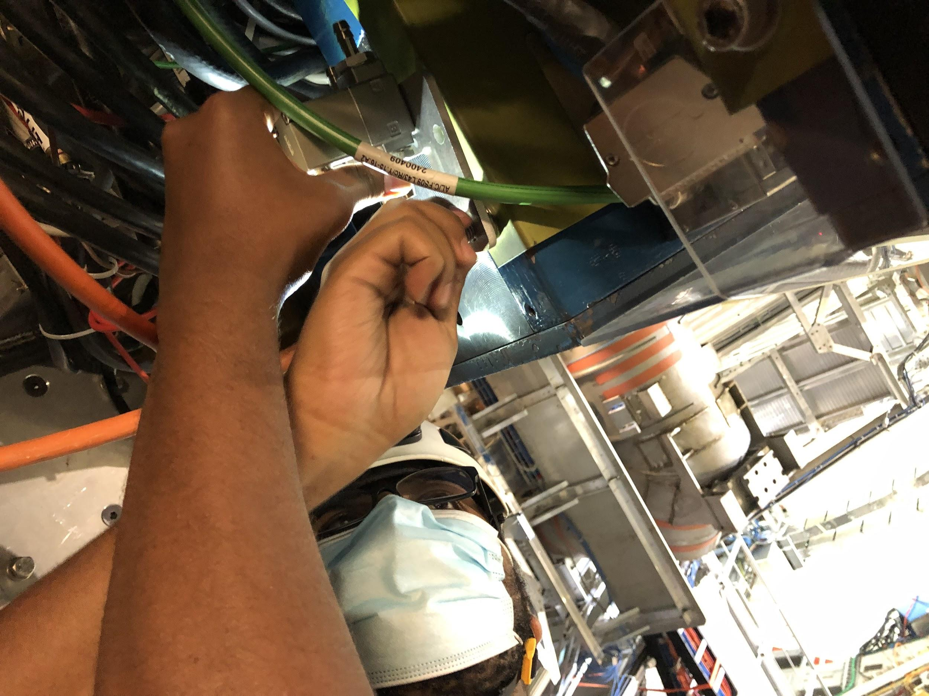
Current Status
Mounted and connected valves on 59/64 of the modules on EBC
EBC 04, 08, 14, 16, and 25 were difficult to mount on and were skipped
Later:
Begin work on EBA (in November)
Continue building/testing valves so there is enough to complete EBA
Replace clear hoses with radiation-safe black ones
Connect air hoses

Slide 37
Pictures:)

Slide 38
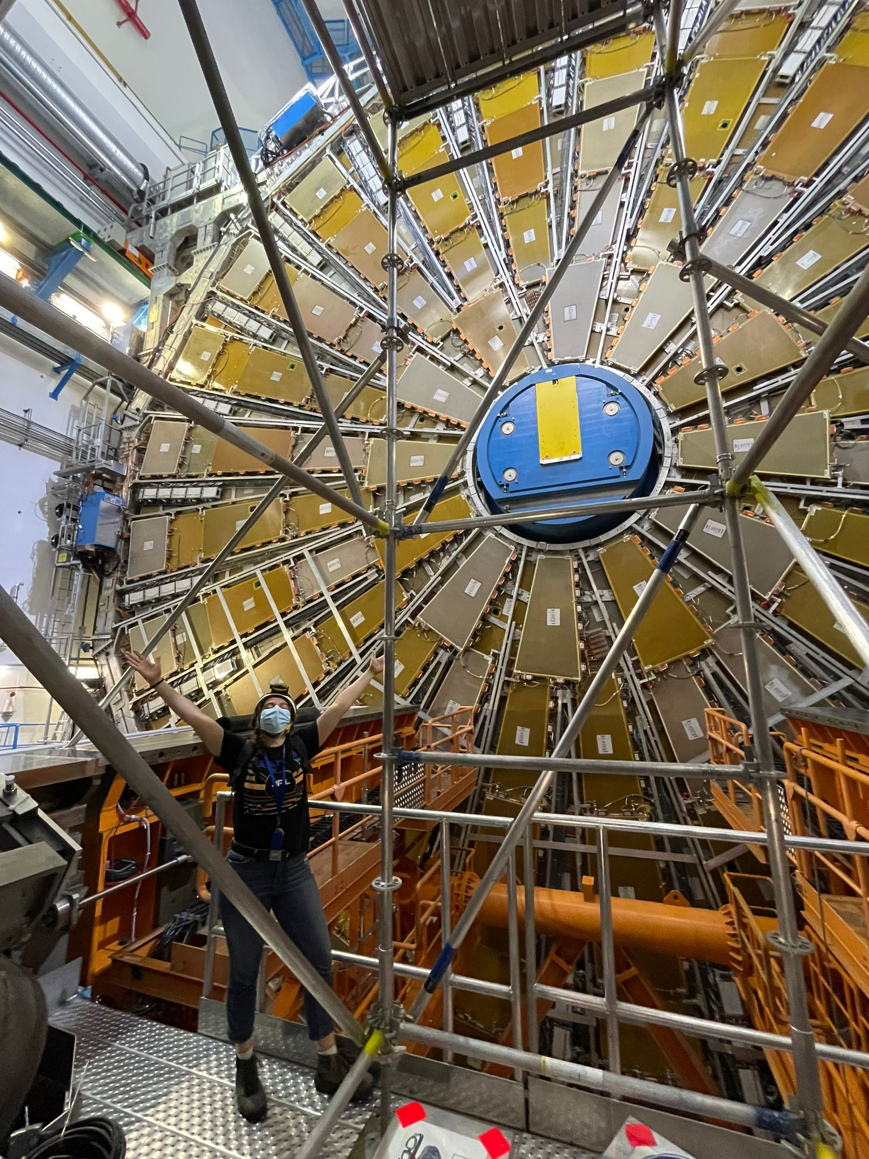
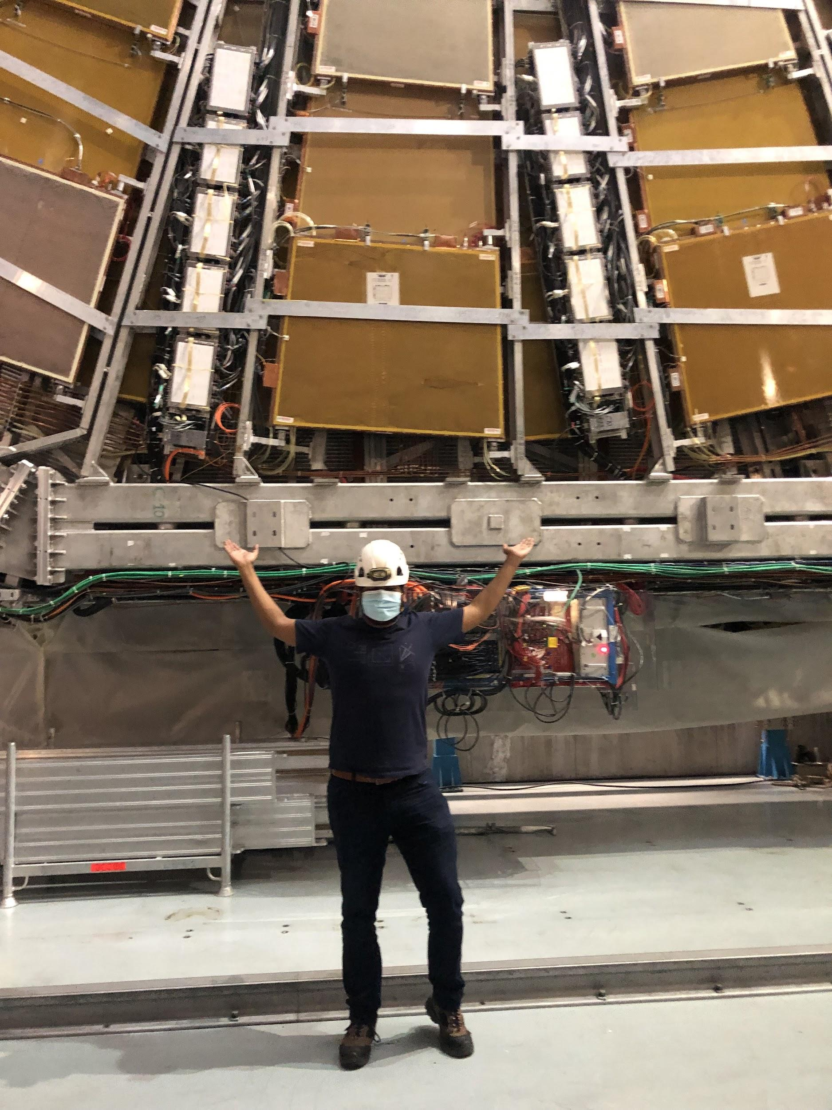

Slide 39
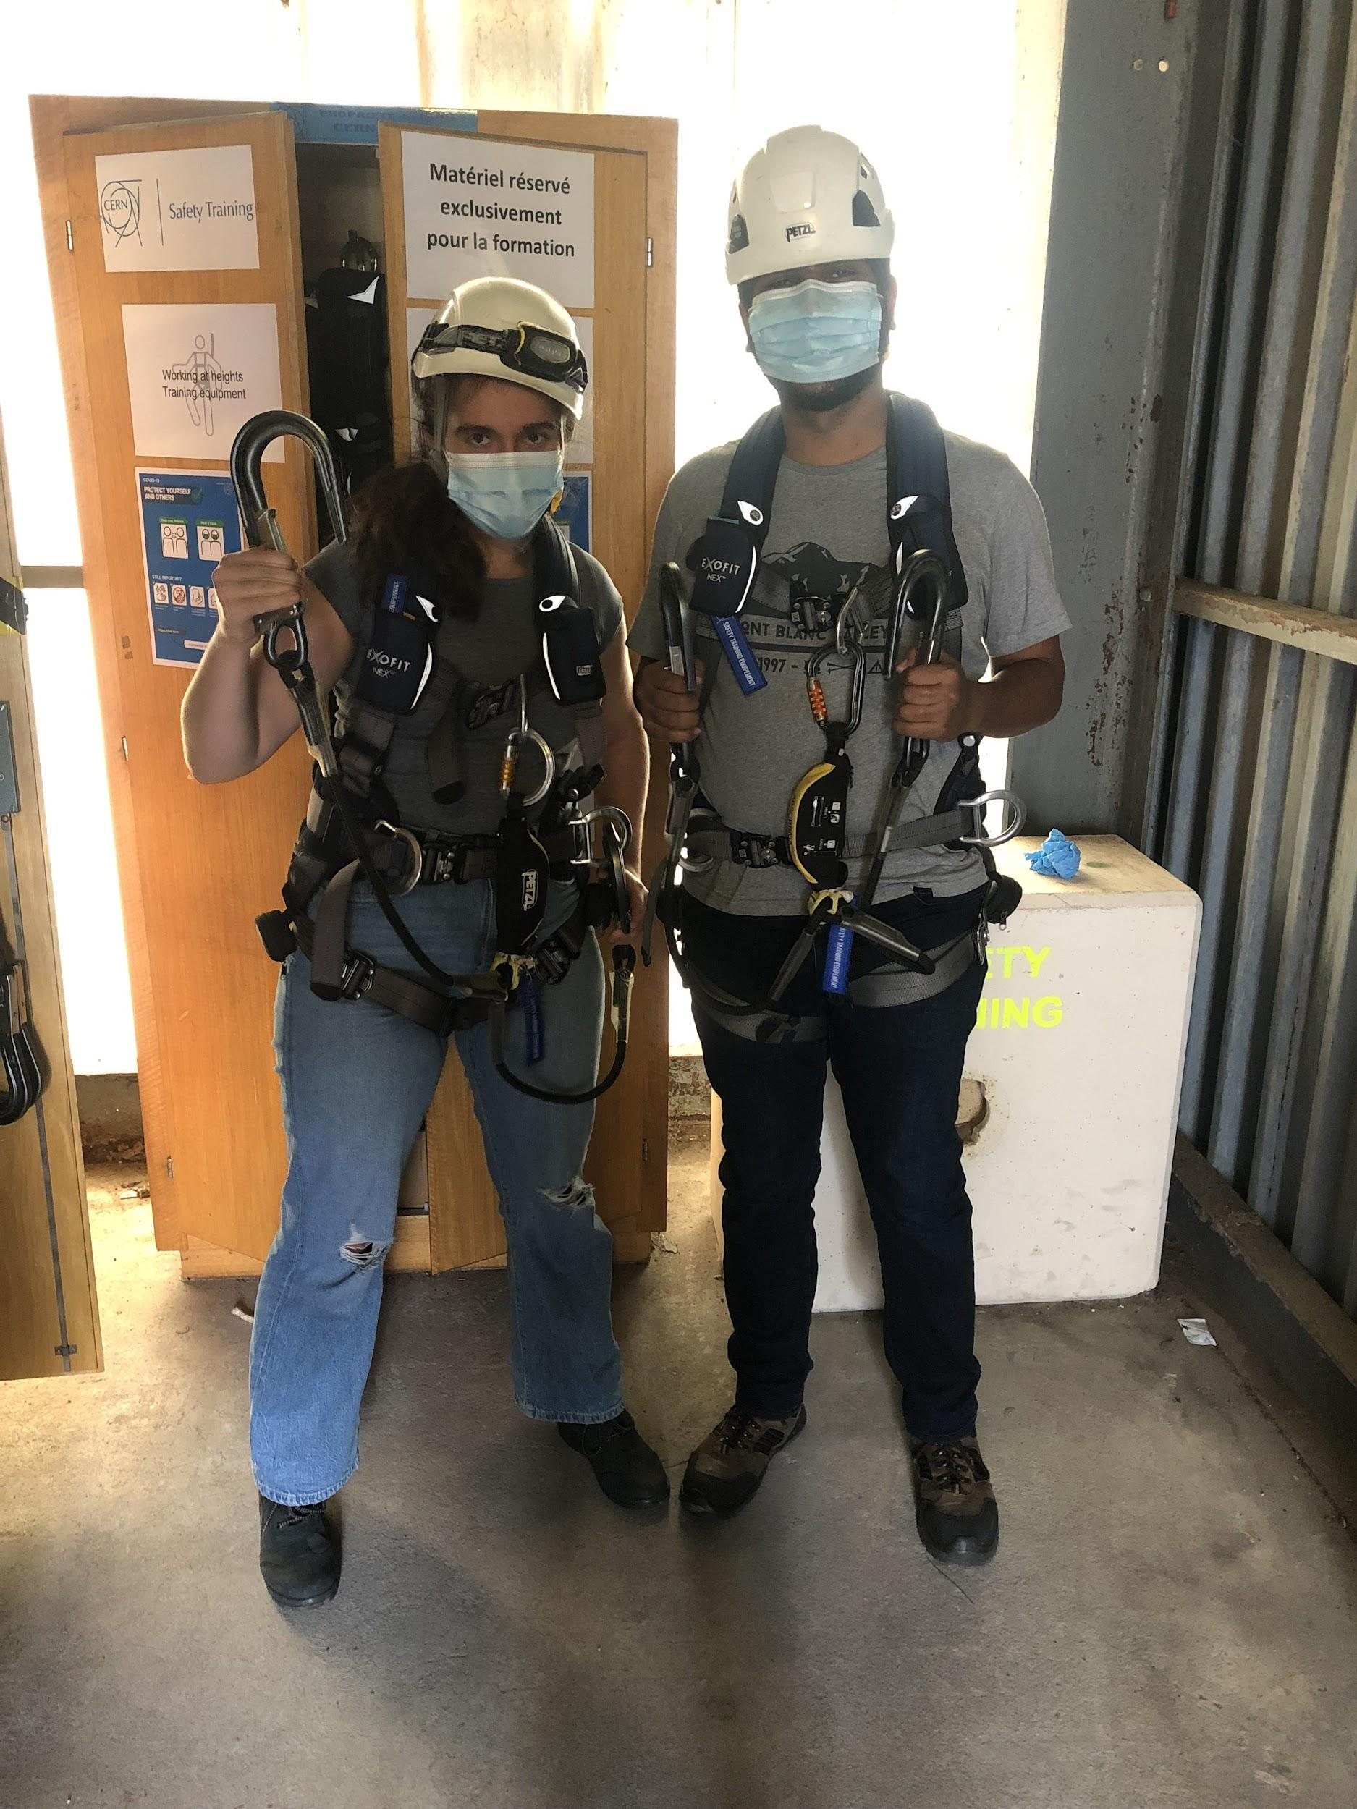
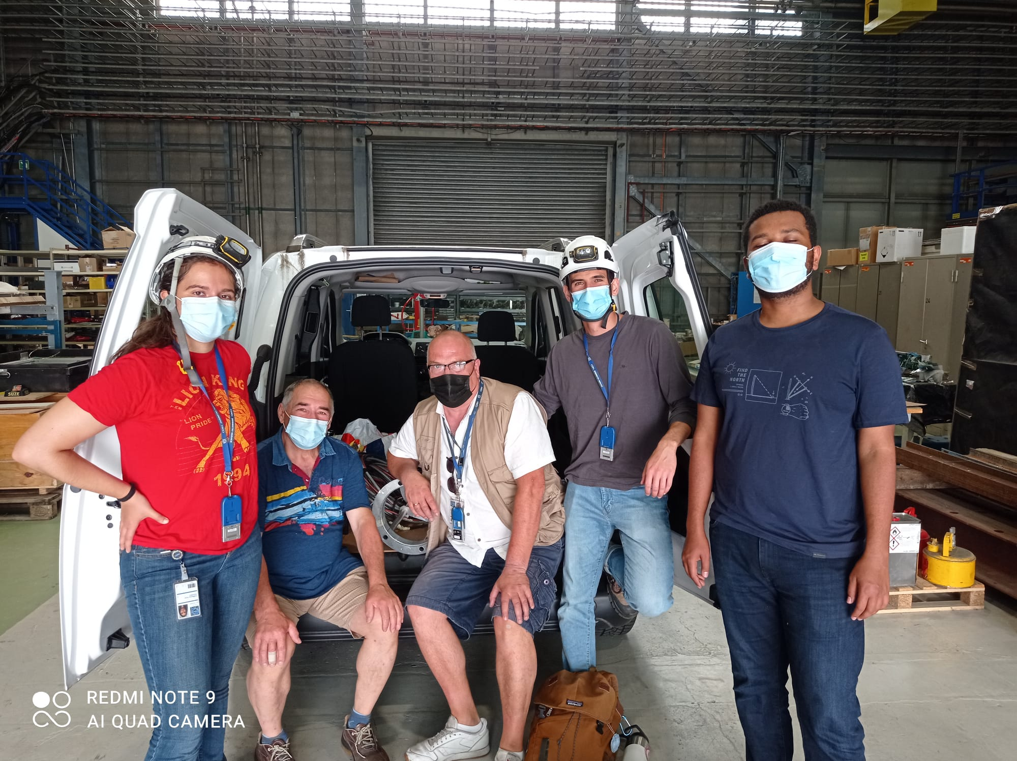

Slide 40
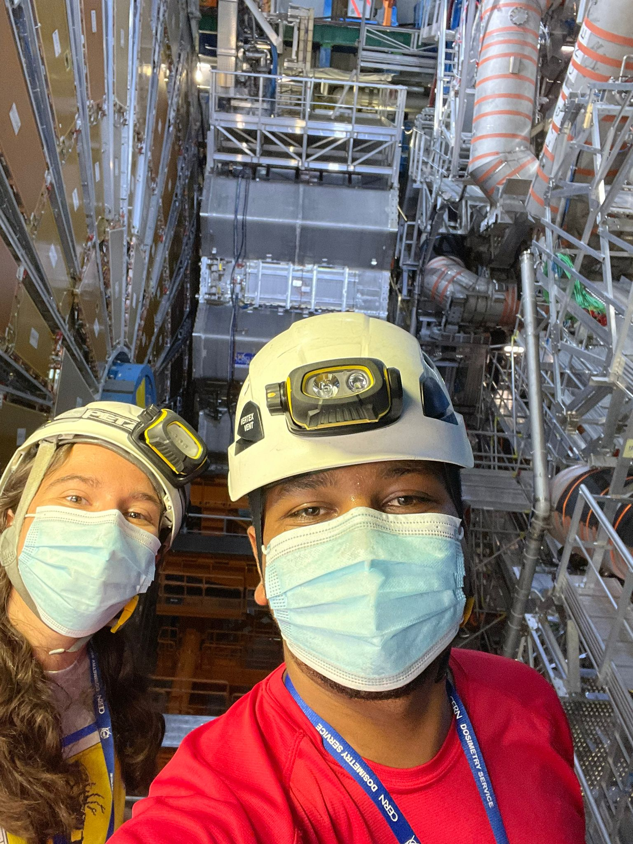
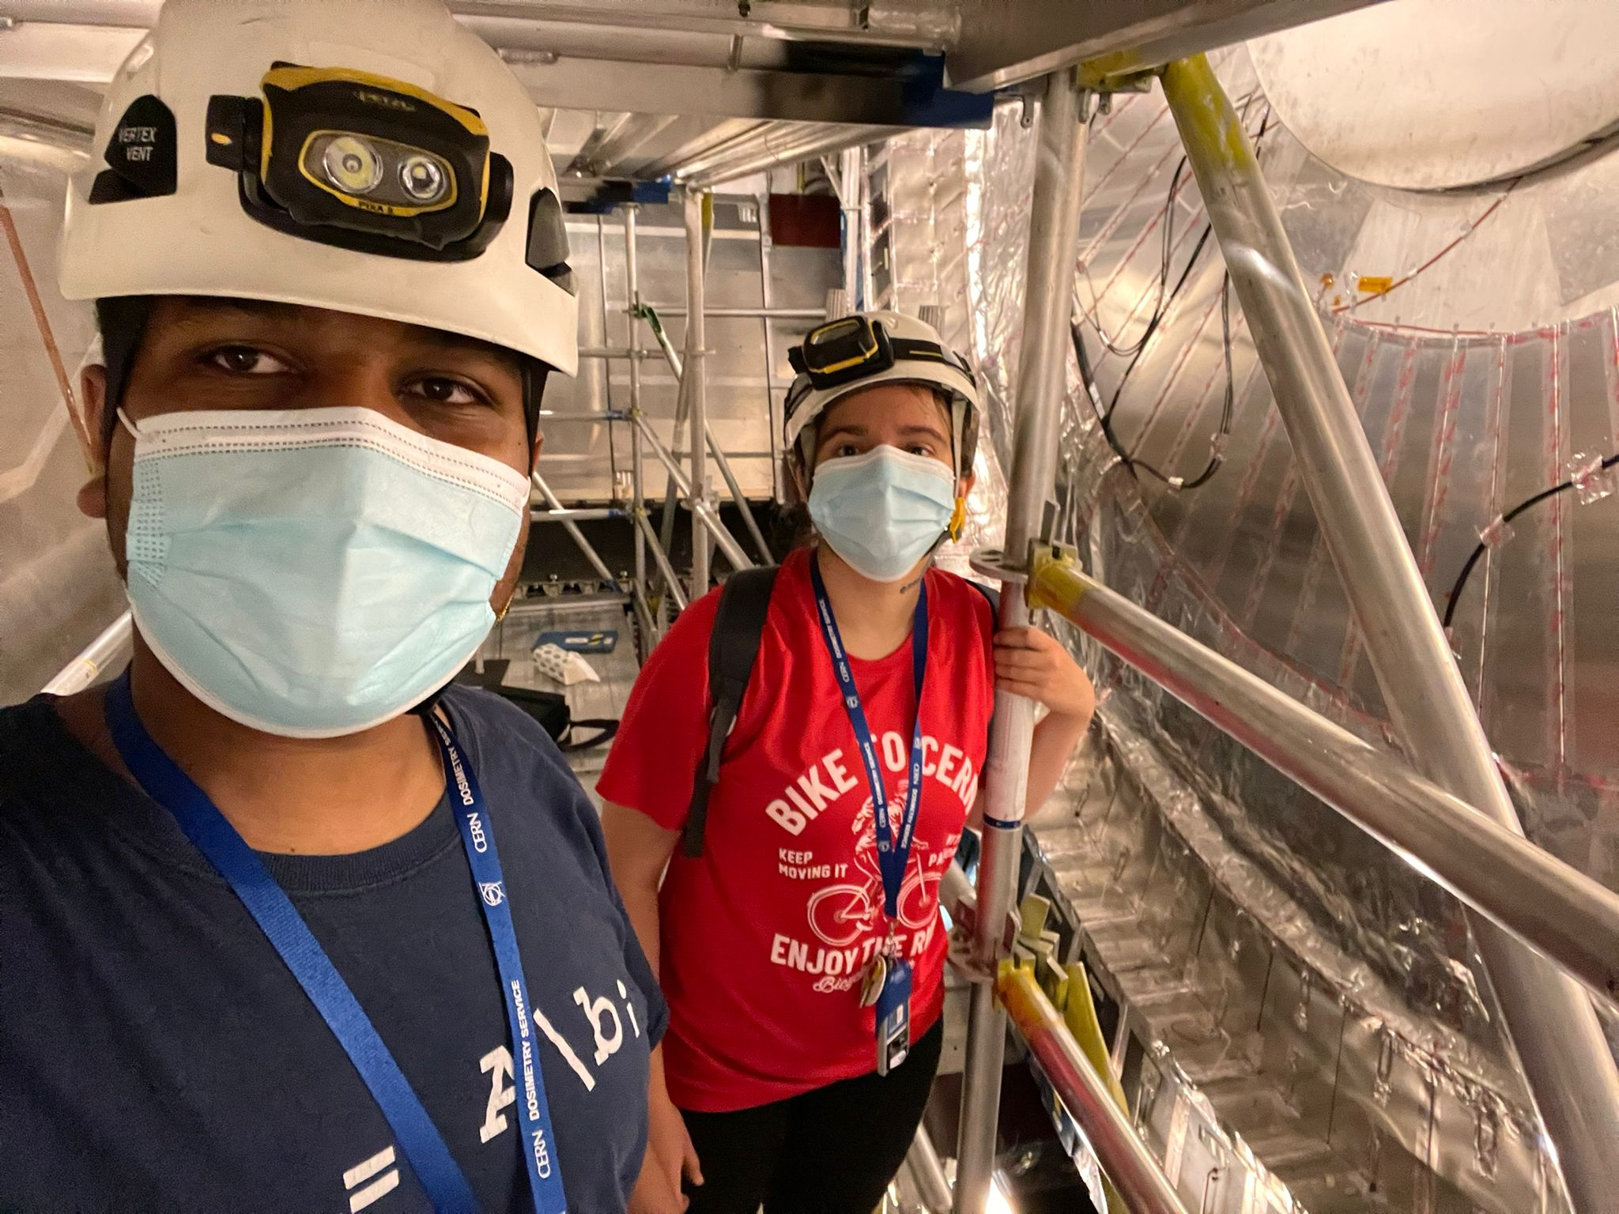

Slide 41
Thank You!

